Slide 1
THE INVENTION OF TEMPLE SPECTACLES
Charles Letocha, M.D.

Slide 2
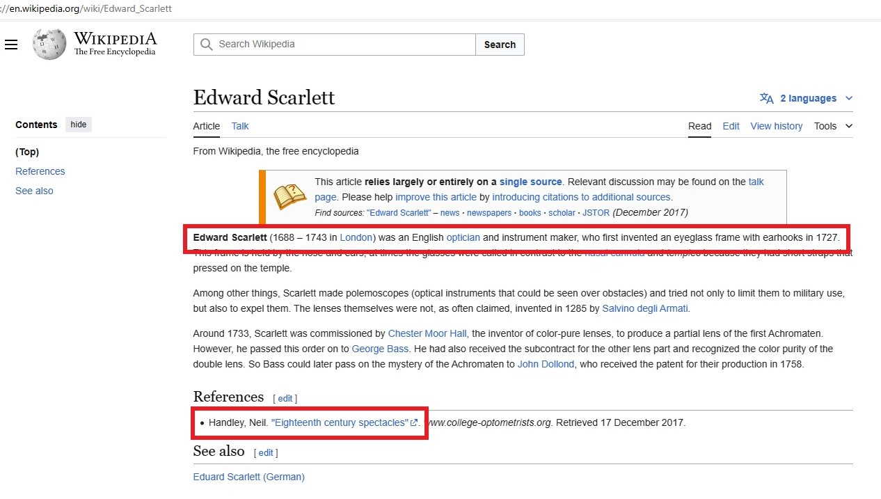

Slide 3
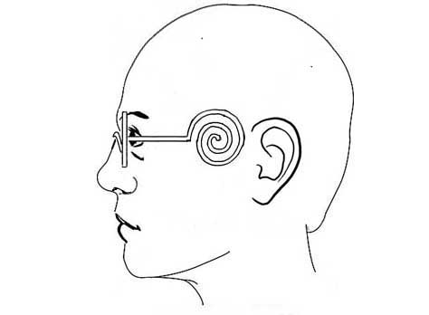
Nomenclature
Bow
Arm
Leg
Shank
Limb
Ears
Branch
Temple
Side
Hold-fast
Side bar
Ear hook
Ear rail
Ear bar
Side piece
Temple piece
Temple side
Spring-spectacle
Finial
Loop
Ring
Wig loop

Slide 4
Can we verify or disprove Wikipedia’s claim?
Many 18th century newspapers have been digitized
The Science Museum and British Library, among others, have collections of trade cards
I have looked at many of these. I did not look at non-English language newspapers but, in the past, others have. Current historians who read German, French, Dutch and Italian report that they have discovered nothing new in those languages
Let’s look sequentially at what has been found

Slide 5
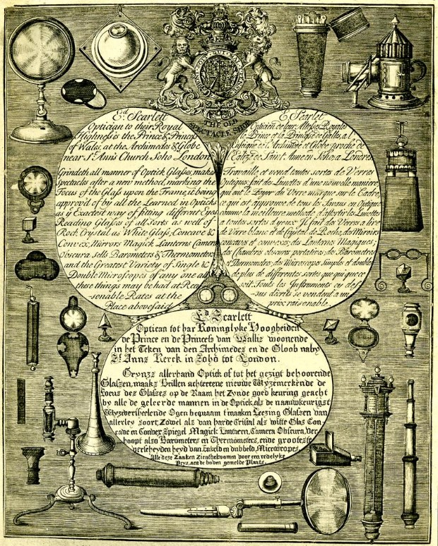
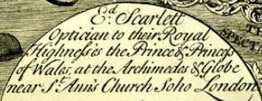
Edward Scarlett trade card, 1727 or earlier
Bodleian Library, Oxford

Slide 6
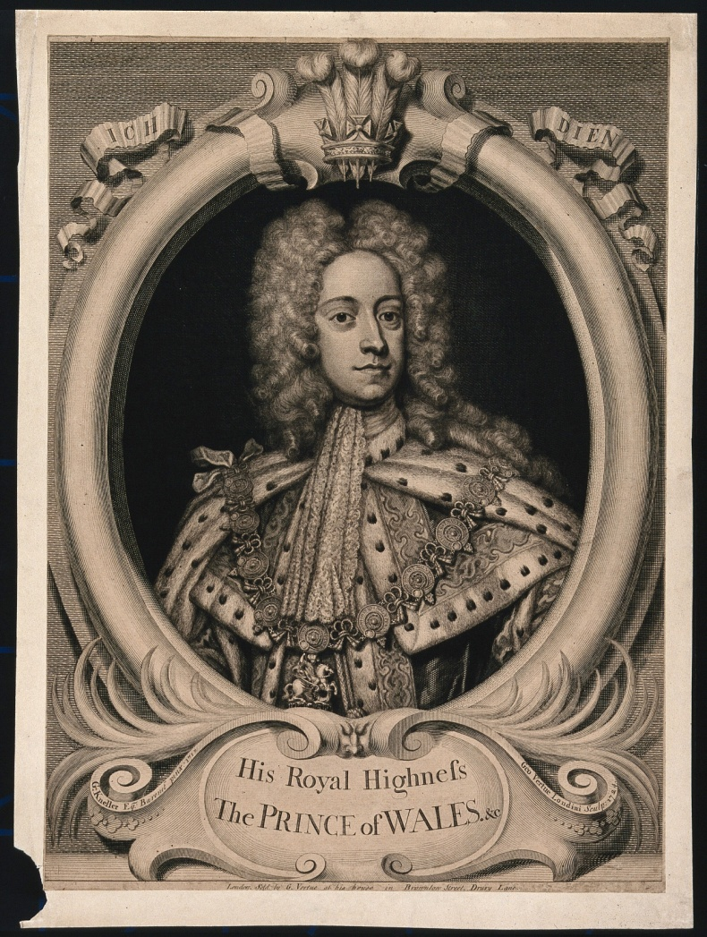
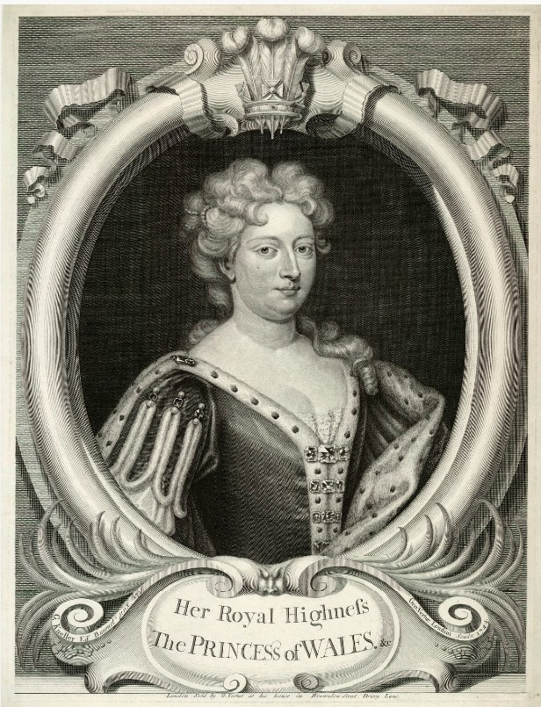
Ascended the throne as George II on June 11, 1727

Slide 7
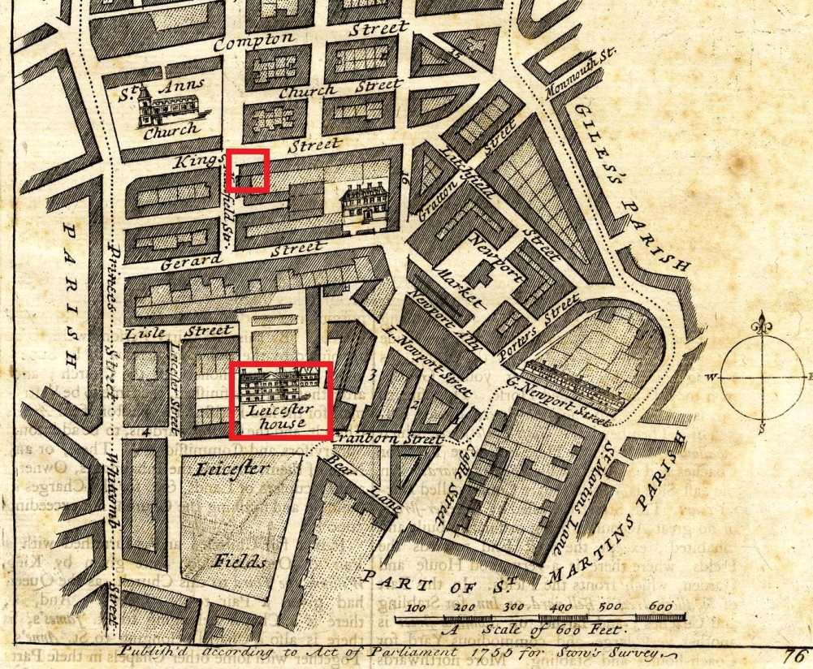
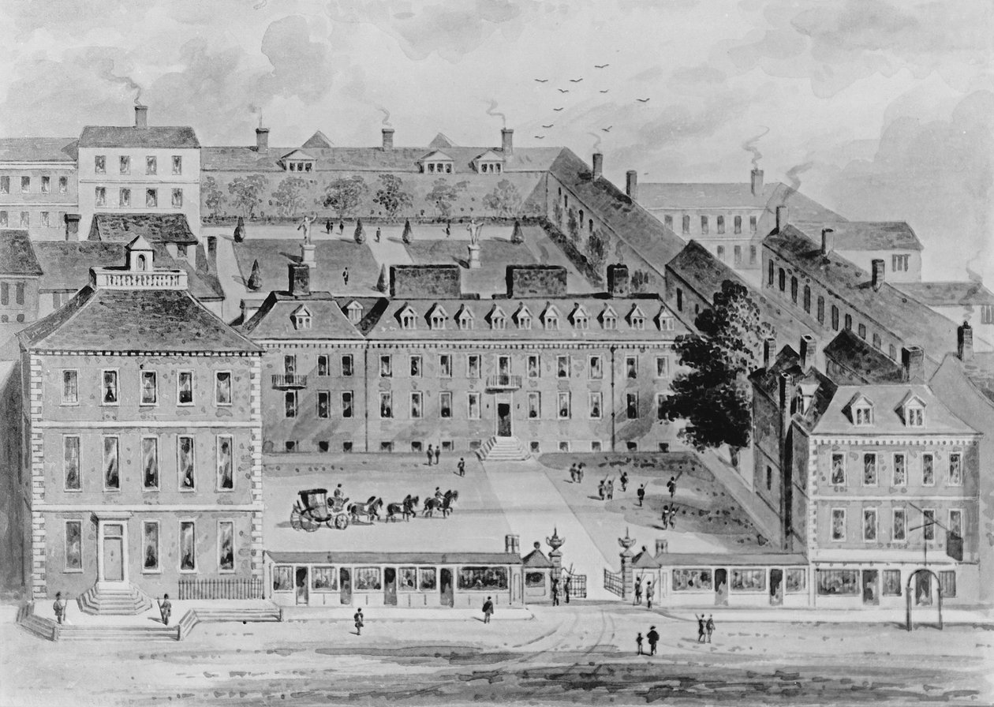
Royal Warrant
Prince and Princess of Wales lived at Leicester House from 1717 until 1727
It was located just a couple of blocks from Scarlett’s shop
Therefore, the broadsheet must date between 1717 and 1727

Slide 8
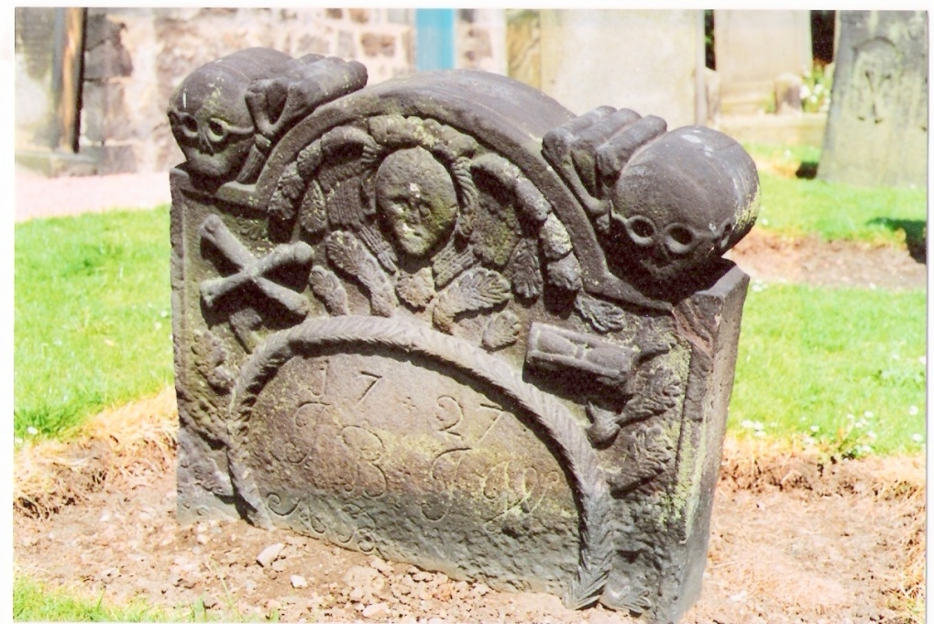
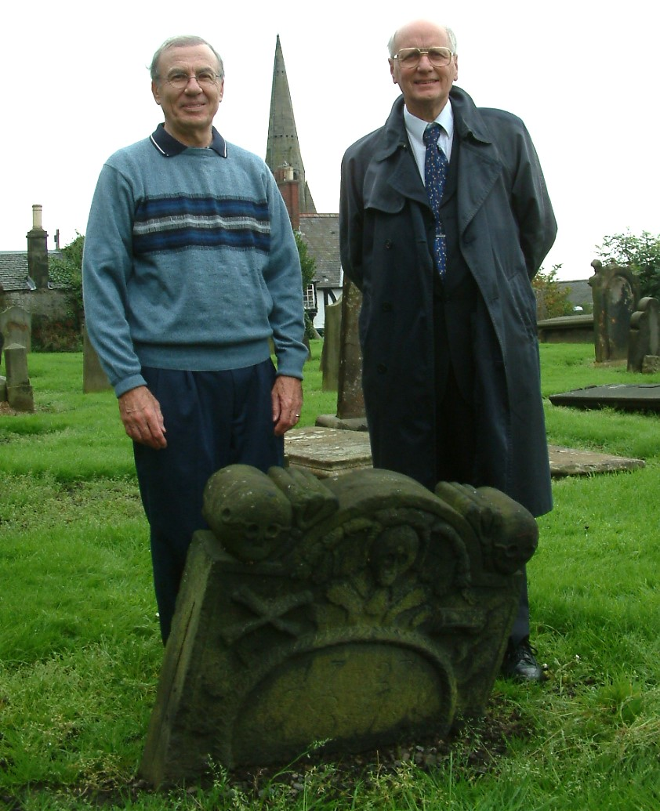
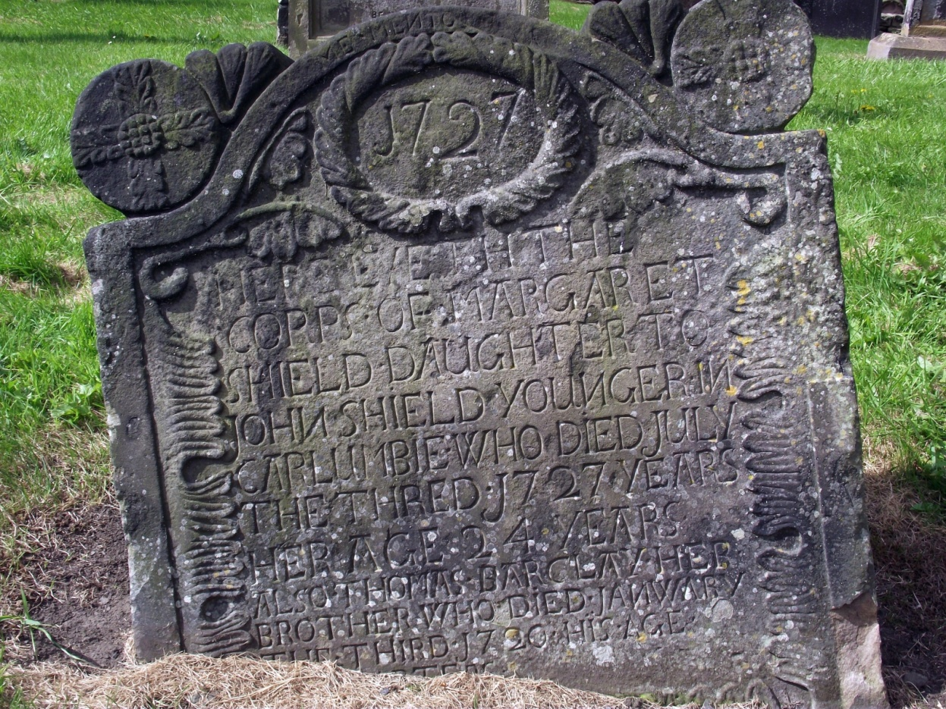
Kirkliston, 1727

Slide 9
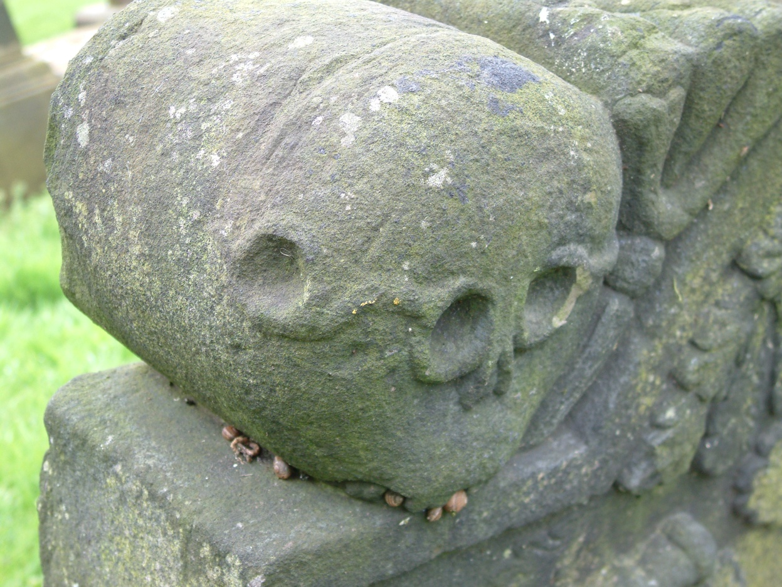
1727 –
Here Lyes the Corpse of
MARGARET SHIELD Daughter of
John Shield, Younger in Carlumbie
Died 3 July 1727 Her age 24 years.
Also THOMAS BARCLAY her brother
Who died January the Third 1720

Slide 10
In the 18th century, Scottish families liked to have unique headstones
If temple spectacles had been invented around this time, one can speculate that the new feature of the temple piece might have intrigued the family
Nothing is known of the life of Margaret Shield, her brother or father

Slide 11
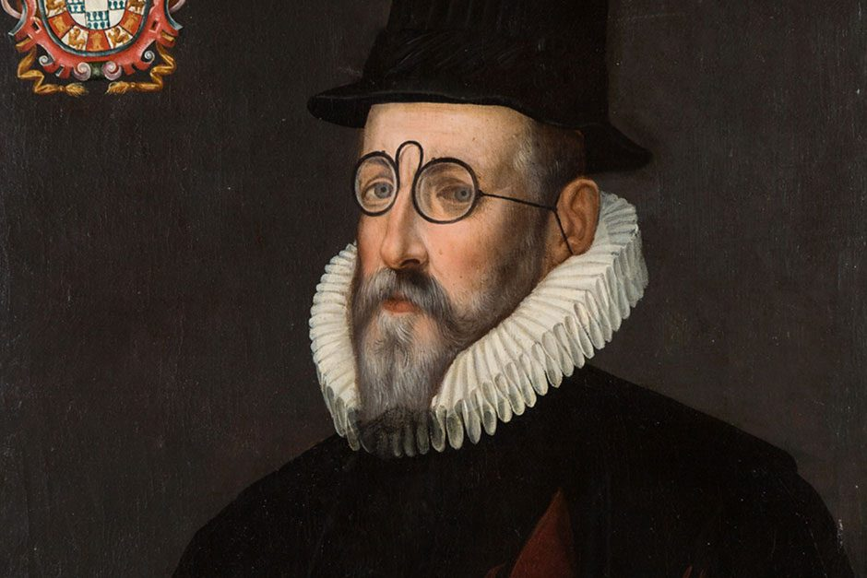
To play devil’s advocate, could the skulls possibly be using wide loops around their “ears”?

Slide 12
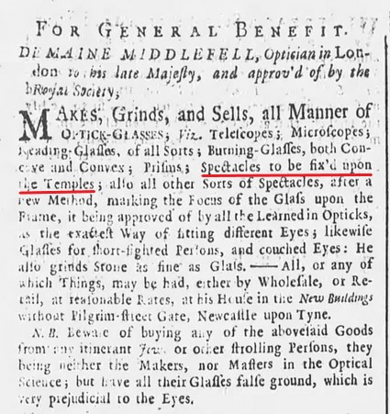
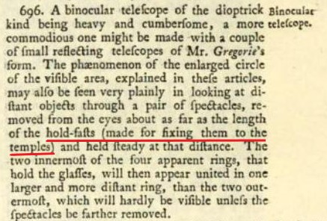
Newcastle Courant, 9/23/1738
Robert Smith, Opticks, 1738

Slide 13
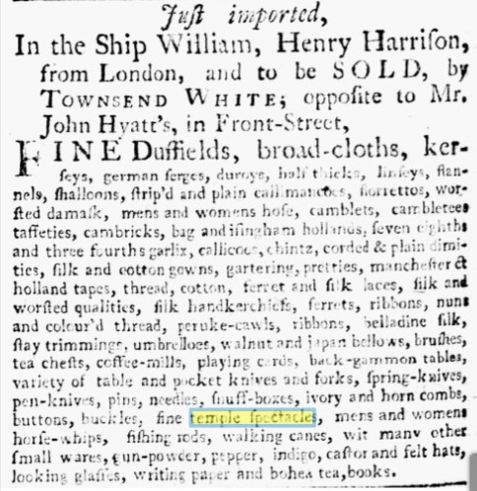
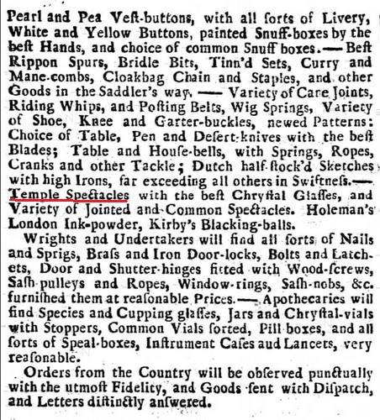
Pennsylvania Gazette, 9/23/1742
Caledonian Mercury, 9/26/1743

Slide 14
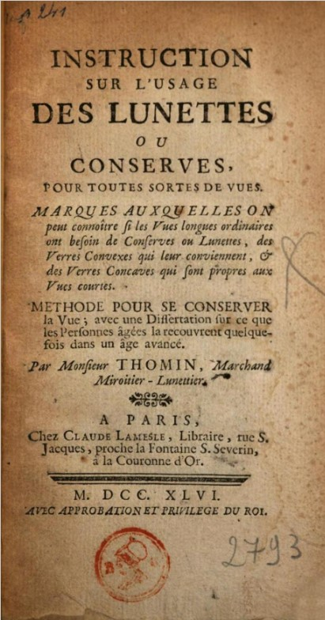
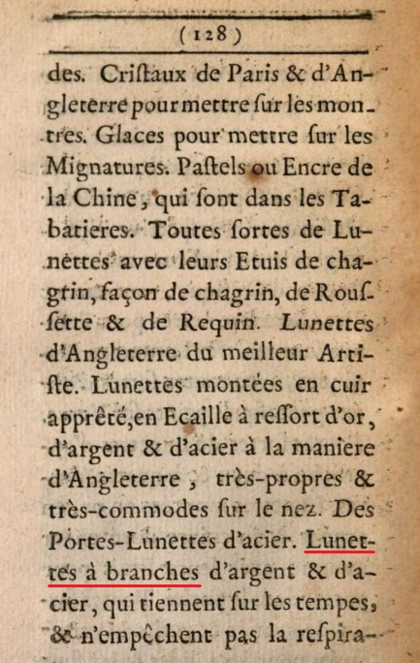
1746 – Marc Thomin
Glasses with silver & steel temples, which fit over the temples, & don't take away the freedom to breathe

Slide 15
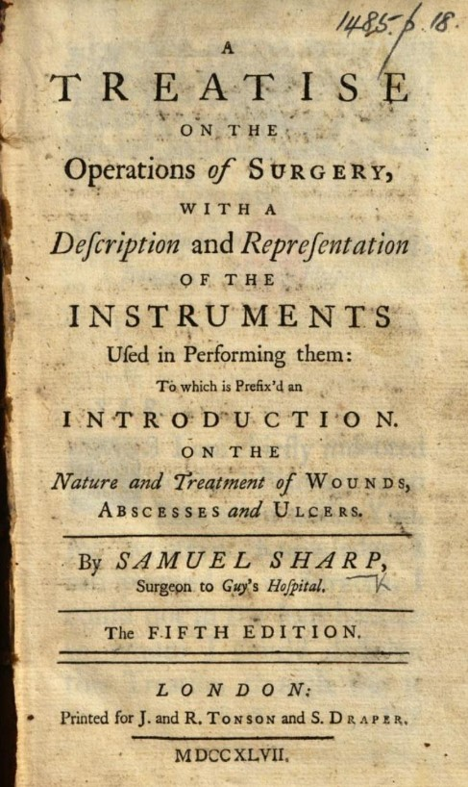
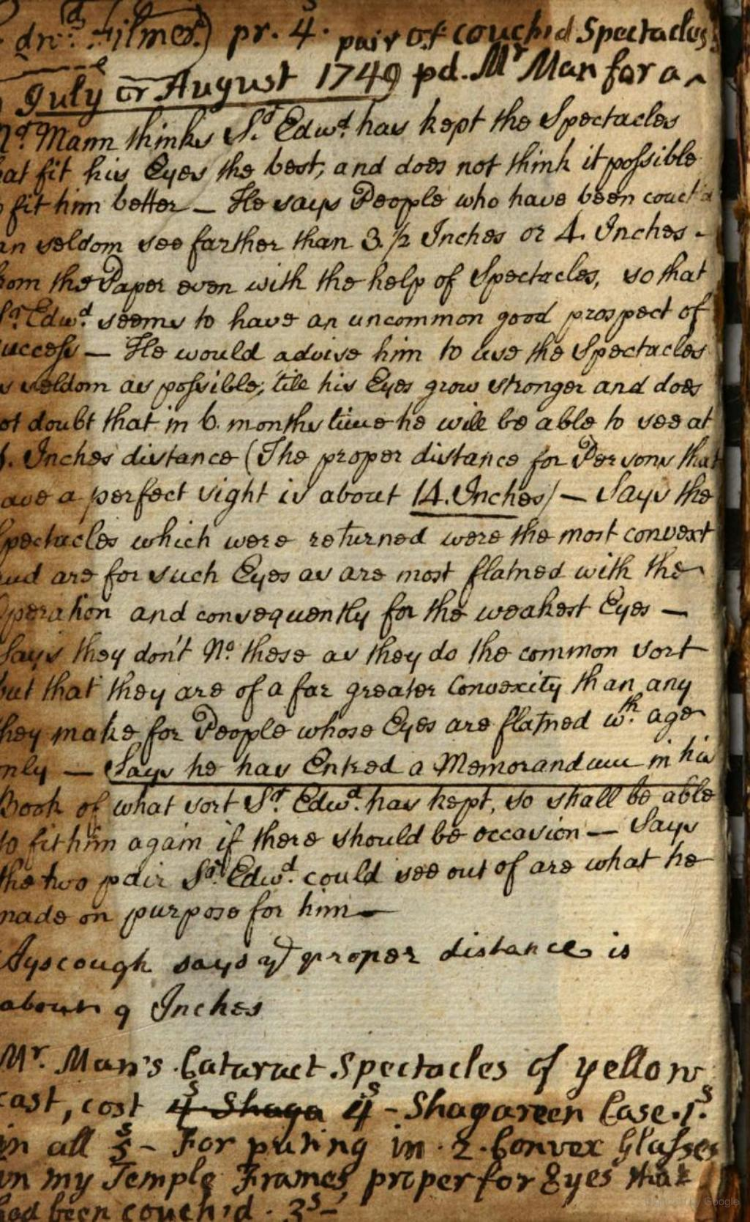
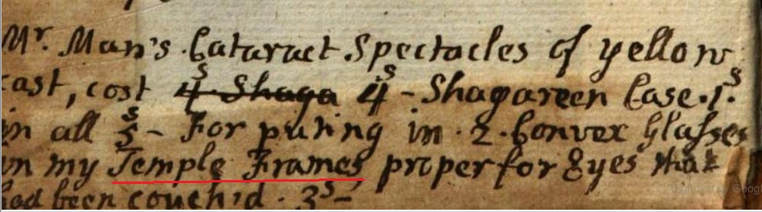
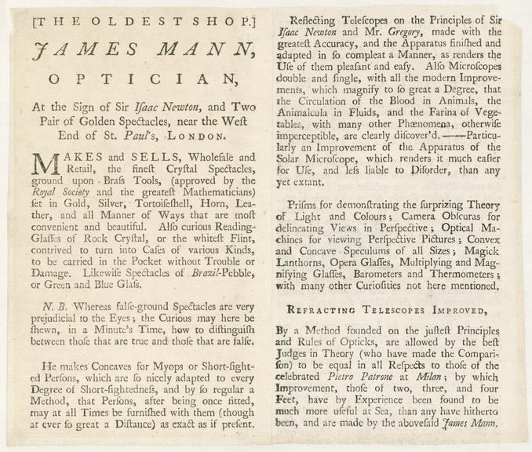
1749 – Aphakic temple spectacles purchased from James Mann II

Slide 16
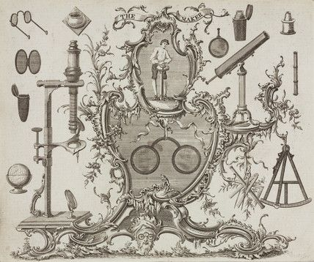
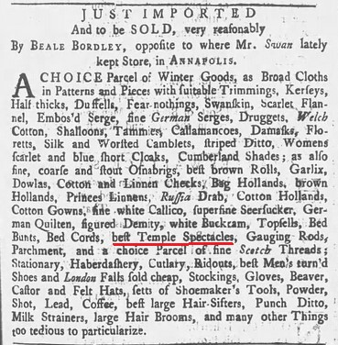
1749 – James Ayscough trade card
Maryland Gazette, September 26, 1750

Slide 17
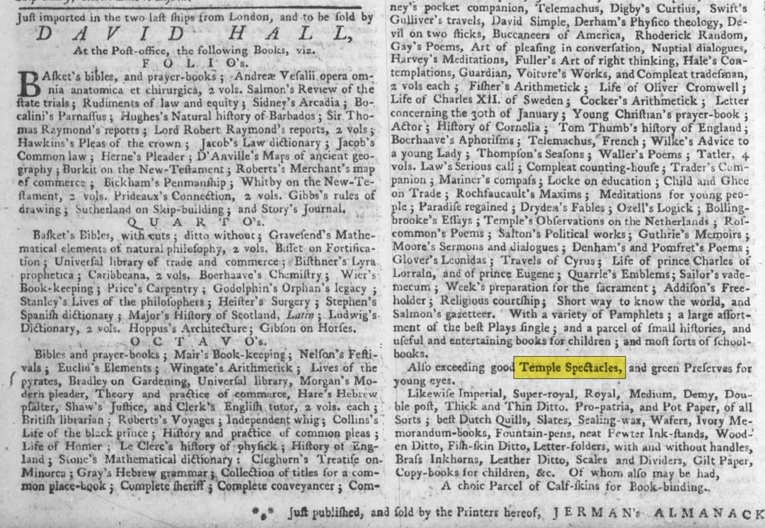
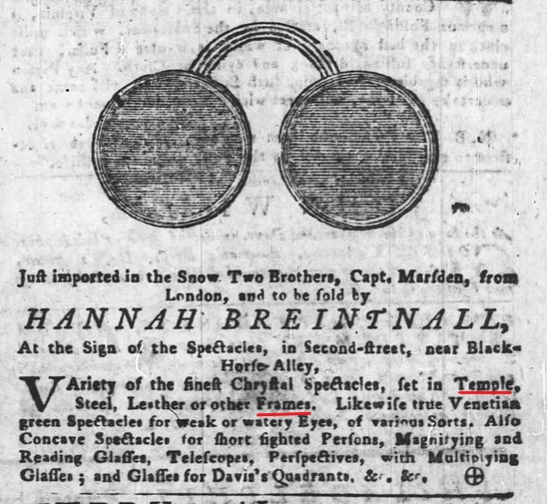
Pennsylvania Gazette, December 12, 1751
Pennsylvania Gazette, March 30, 1758

Slide 18
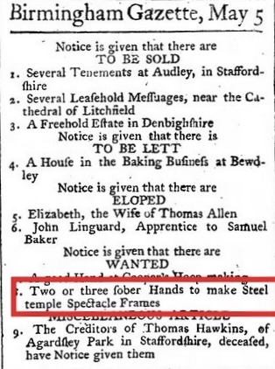
Public Ledger, May 8, 1760

Slide 19
James Ayscough (1720-1759)
Born in Wiltshire, he was the son of a clergyman
He apprenticed with James Mann, Jr. from 1743-1748
Ayscough set up his own shop at 33 Ludgate Street, near St. Paul’s Cathedral
Having trained with Mann, he became an expert maker of microscopes
He advocated blue or green lenses as helpful to the health of the eye
From 1755 until his death, he kept careful meteorological records which were published in The Gentleman's Magazine

Slide 20
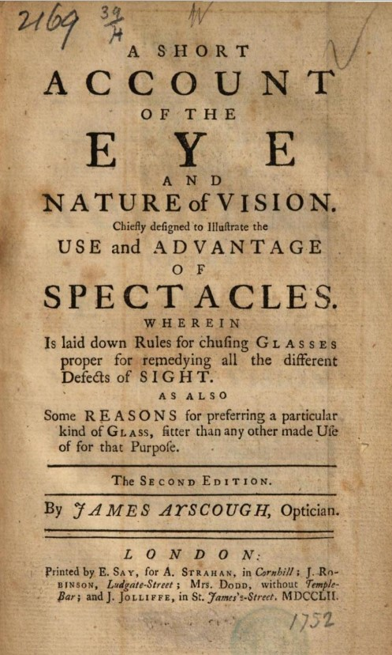
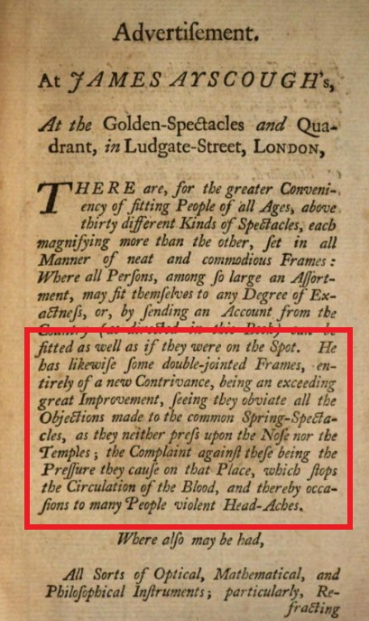
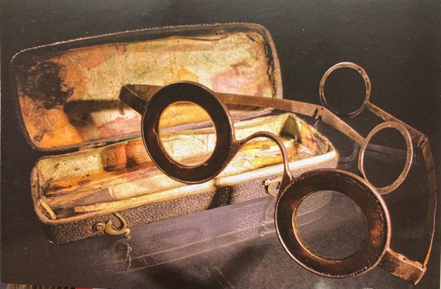
Ayscough temple spectacles – 1752
(not mentioned in the 1750 edition)

Slide 21
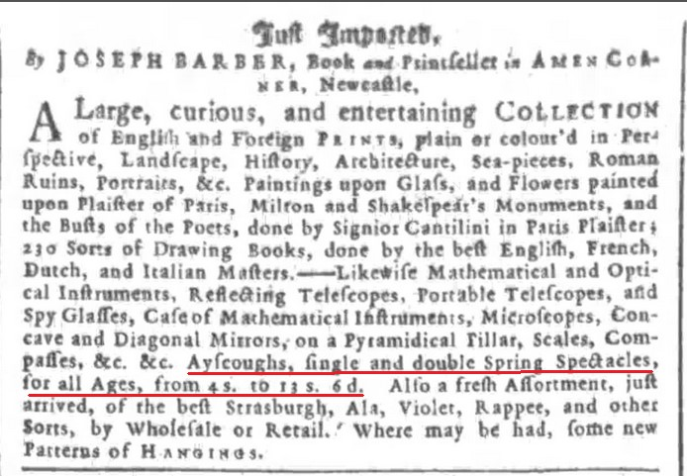
Newcastle Weekly Courant, September 22, 1753

Slide 22
Is there anything to suggest temple spectacles predating 1727?

Slide 23
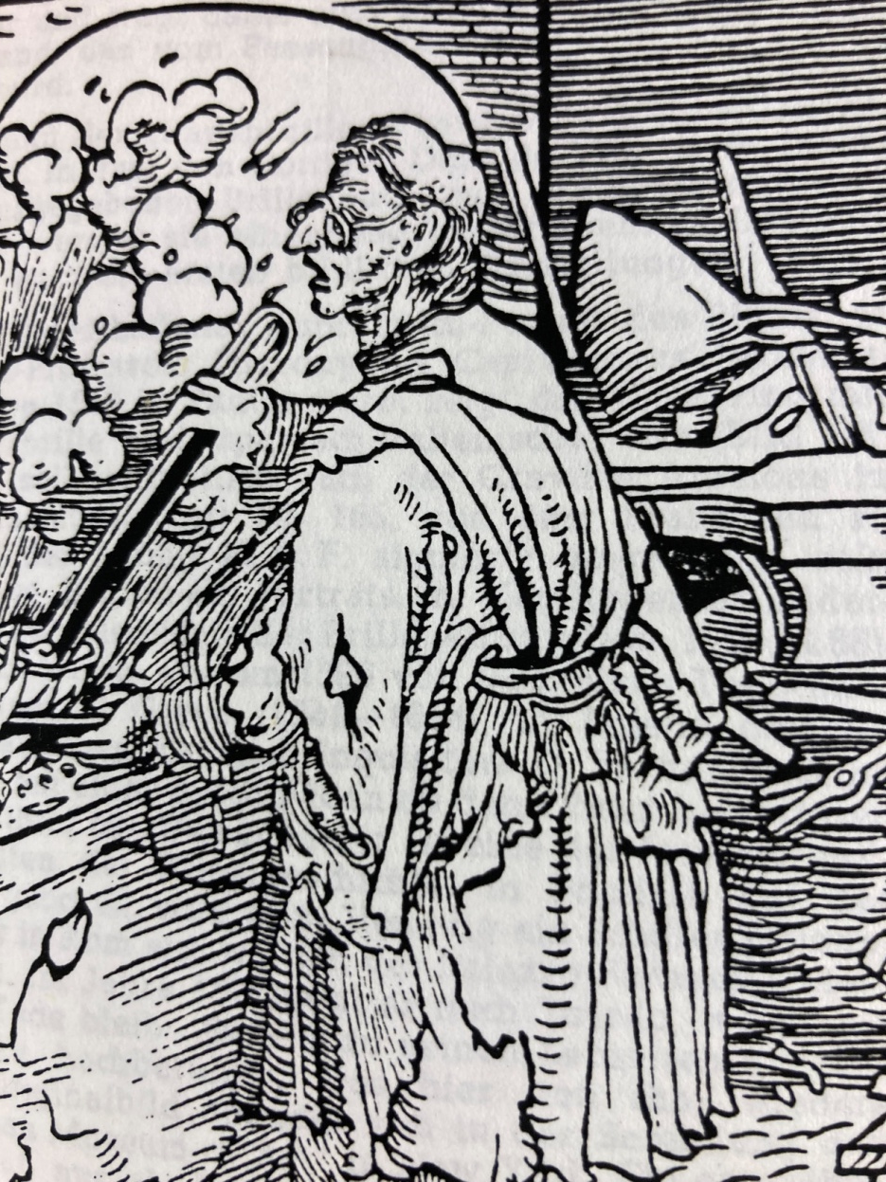
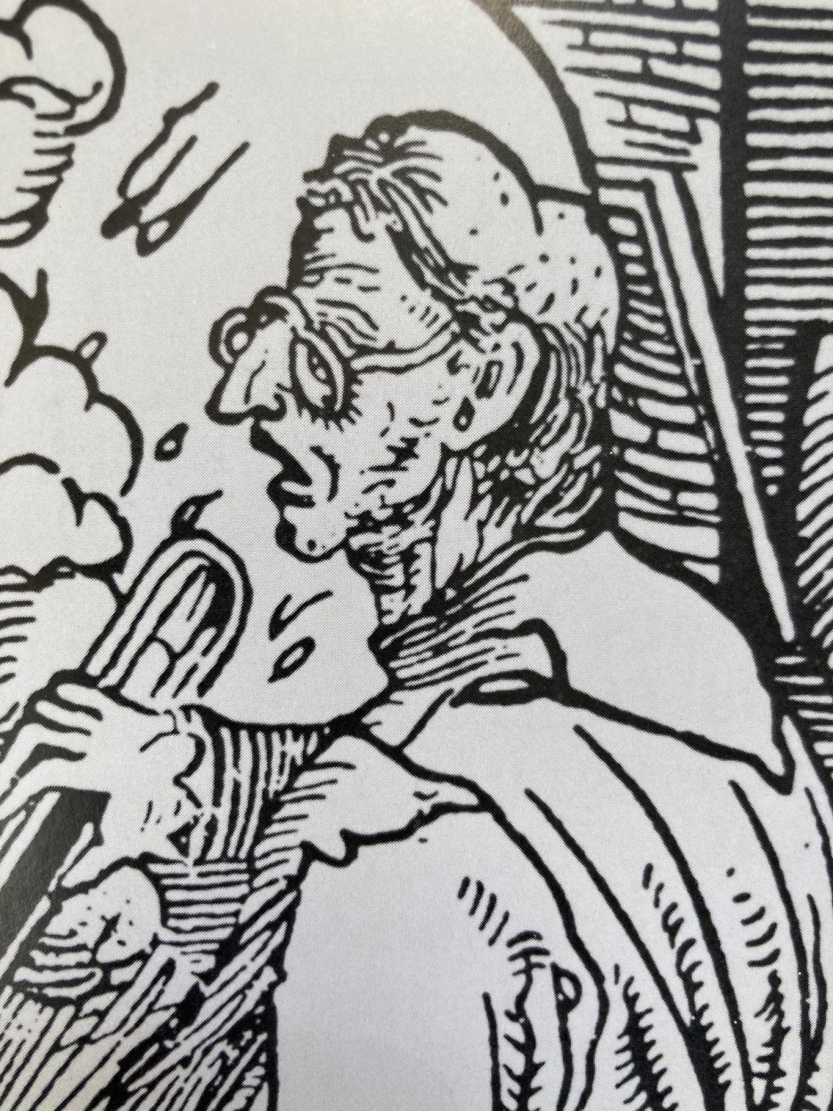
Hans Burgkmair, ca. 1510
Zeiss Collection

Slide 24
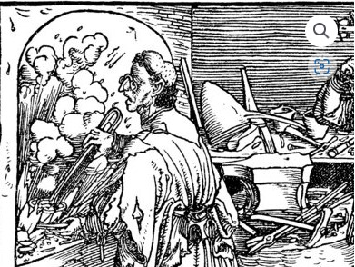
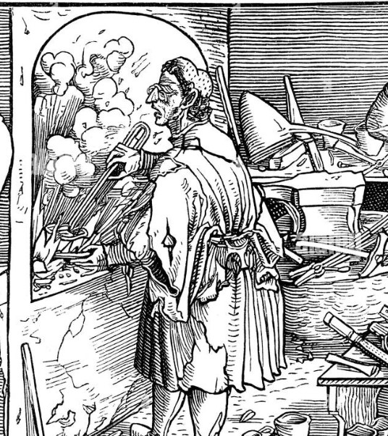
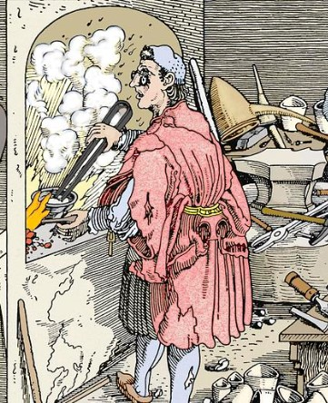
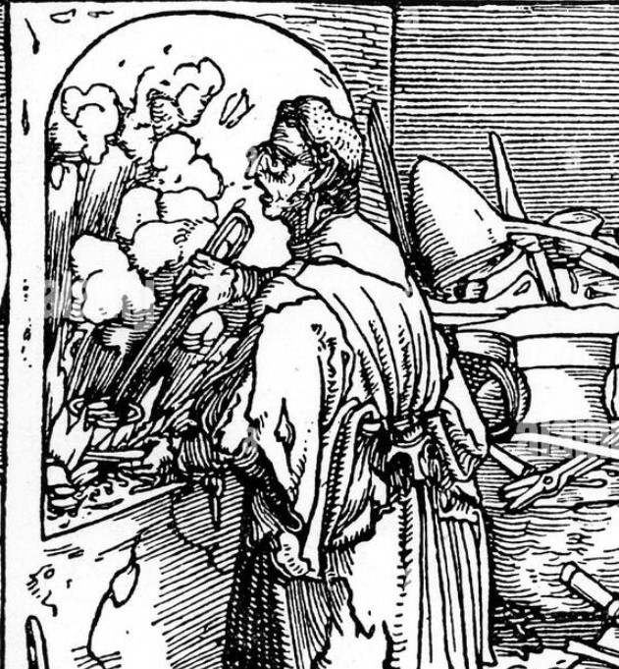

Slide 25
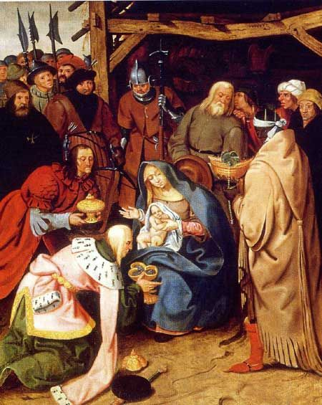
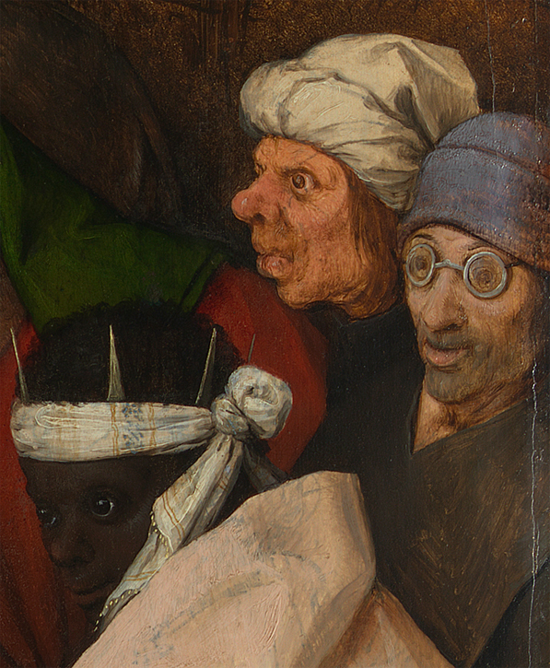
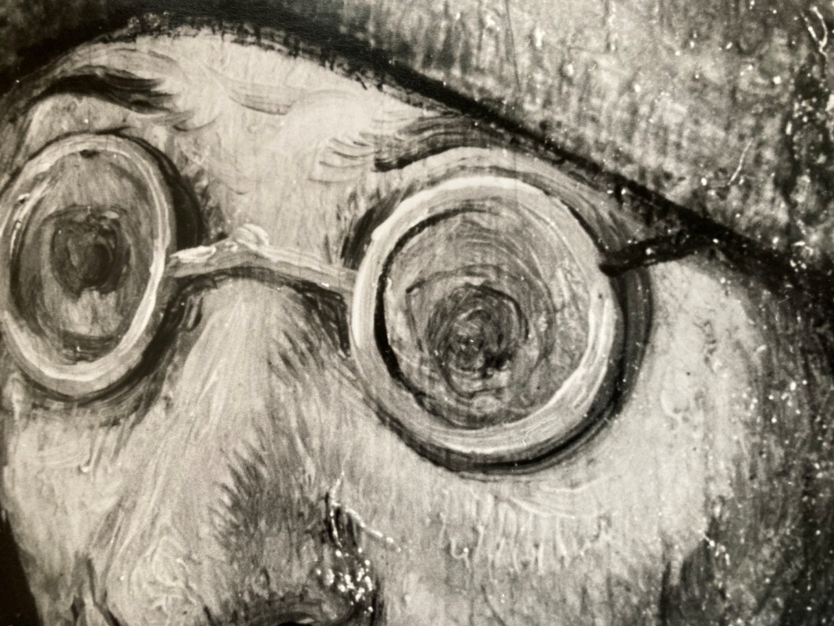
Pieter Bruegel the Elder, 1564

Slide 26
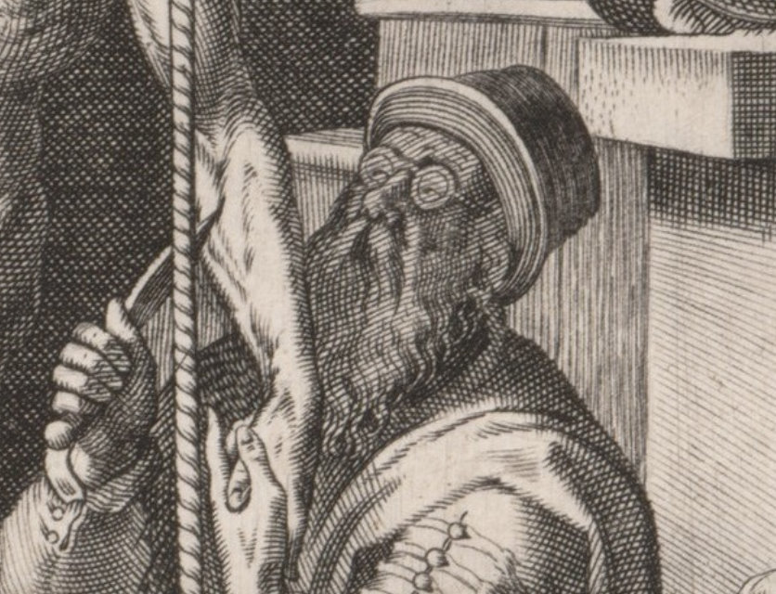
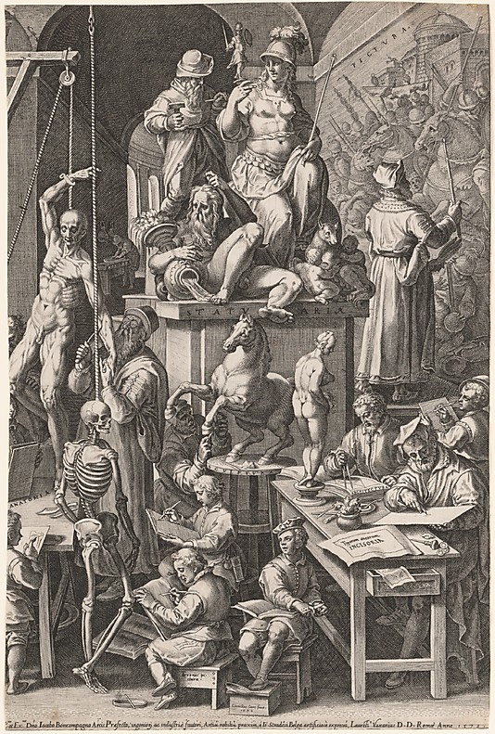
Cornelis Cort, 1578

Slide 27
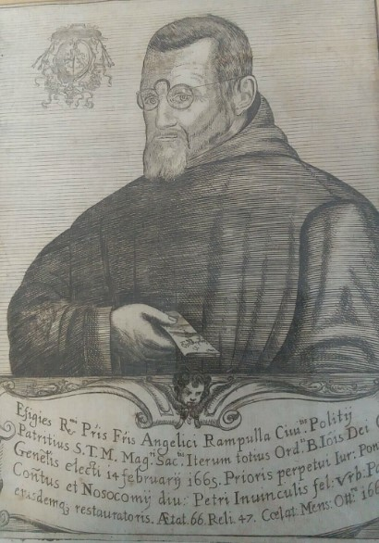
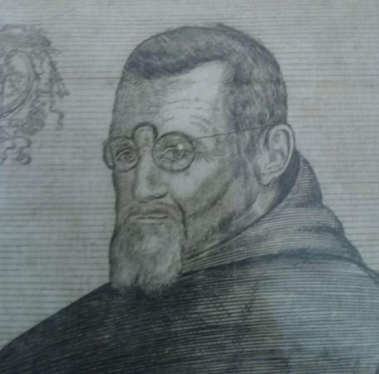
Cords

Slide 28
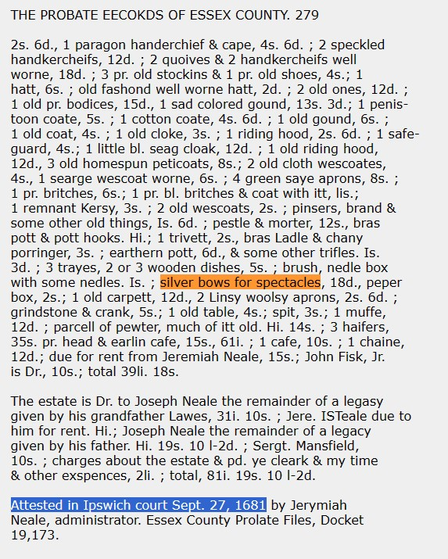
Bows - 1681

Slide 29
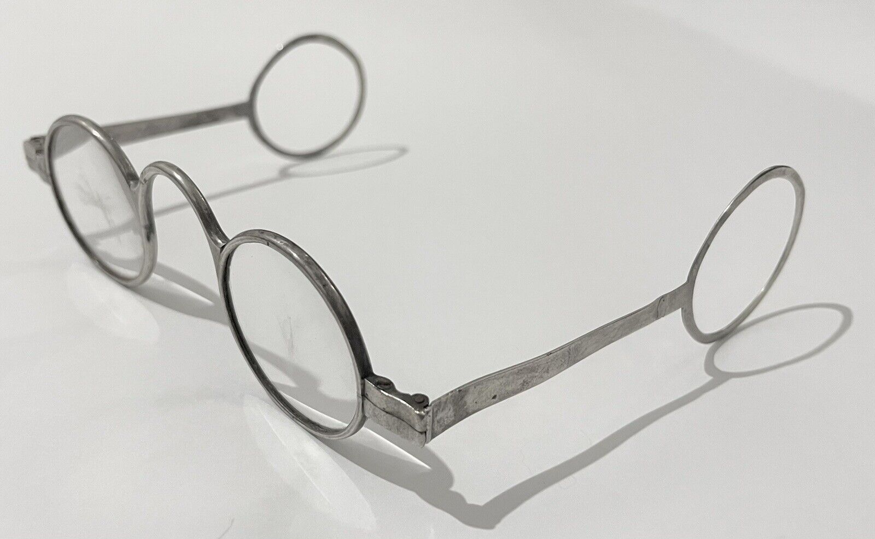
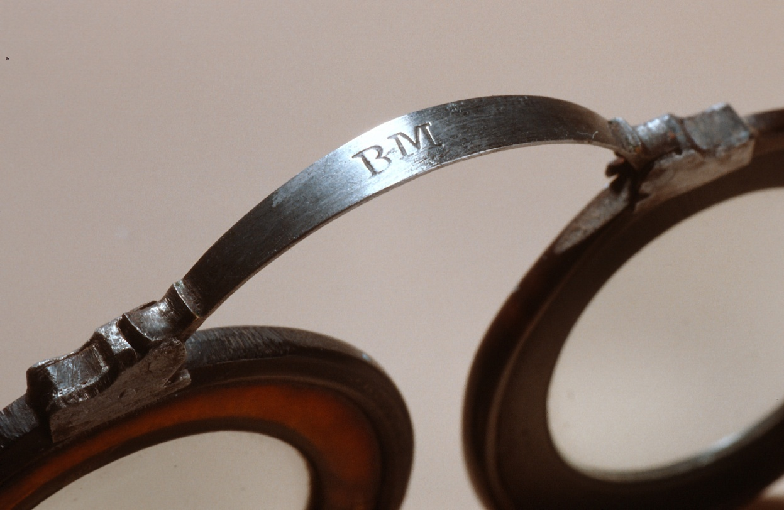
Bows

Slide 30
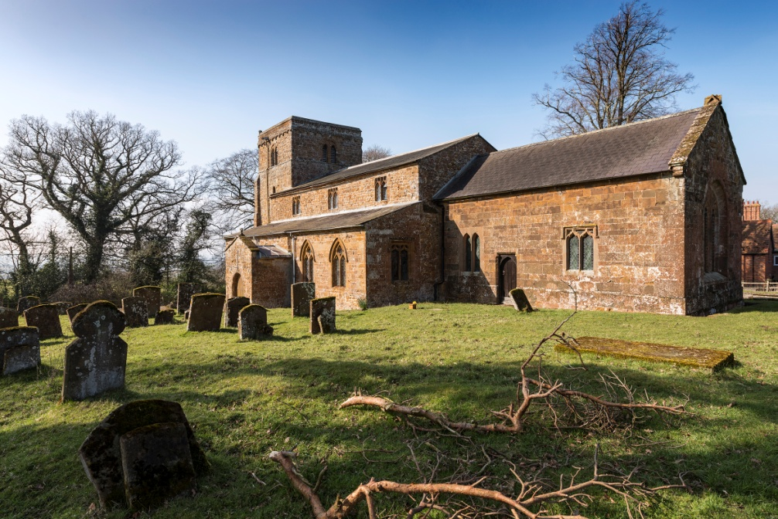
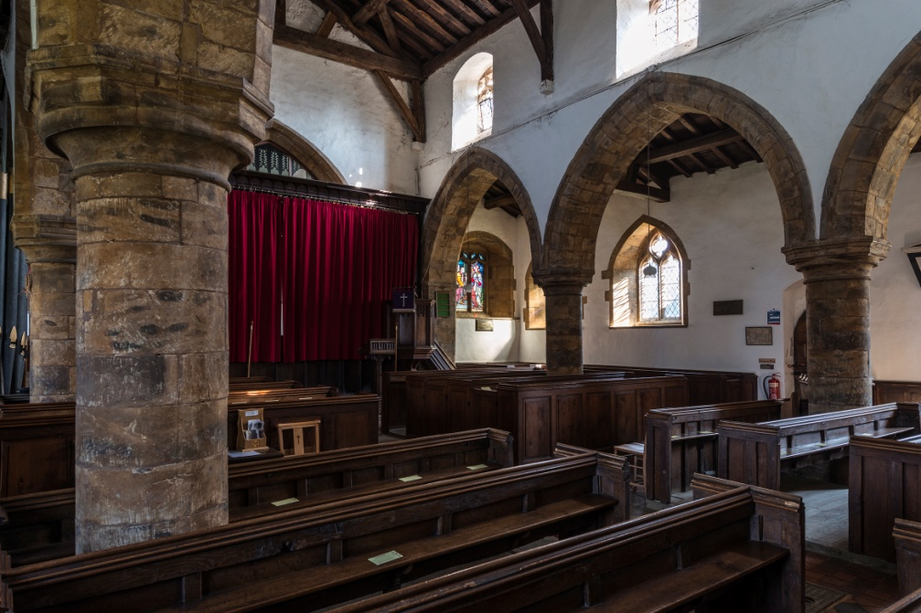
Wormleighton, St. Peter’s Church

Slide 31
There was a 12th century church on this site
Over the following 3 centuries, the church as it now appears was mostly completed
The original rood screen (ornate partition between the chancel and the nave) is 15th century
Current feeling (Neil Handley) is that the screen was originally in Southam Parish Church and removed to Wormleighton in the mid-late 17th century at which time the carving to be seen might have been added to the screen
But, other renovations have occurred in the 18th and 19th centuries

Slide 32



Slide 33

How to date the object
Radiocarbon dating would probably be very accurate with well preserved wood and give an answer within 10 years
Requires ~50 mg of material
But it measures the age of the tree, not the carving

Slide 34


Flip-top case dated 1702
“John D. Fisher”

Slide 35

Jonathan Swift, Journal to Stella, 1710-1711

Slide 36

Alas…

Slide 37


Daily Post, March 3, 1721

Slide 38



Slide 39

Flip-top case dated 1726
This case is in Drew Miller’s collection
Includes 1726 date and symbols of Freemasonry
The Freemasons’ Grand Lodge was established in London in 1717 and its constitution adopted in 1723

Slide 40

Does this represent an intermediate step?
C. J. Robb. The Optician, 1957

Slide 41
Sir Thomas Molyneux (1661-1733)
Native of Ireland
Studied medicine in Dublin and, later, in London. M.D. degree in Dublin, 1687
Highly successful career
Fellow, Royal Society of London
Physician-General of the Army in Ireland
Involved in politics
Philosophical bent
Brother of William Molyneux who postulated Molyneux’s Problem, about how a congenitally blind person would respond if sight could be restored
Baronet, 1730

Slide 42

Sir Thomas Molyneux

Slide 43


Slide 44
Why is this research so difficult?
There are very few advertisements that mention temple spectacles
No mention of anyone extolling their virtues has been located
Following the Scarlett broadsheet, no written mention can be found in the next 10 years
They seem to have been advertised as much (or as little) in the American colonies as in the Mother Country

Slide 45
Modern views about the invention of temple spectacles
Almost three hundred years later, his genius idea to add hinged temples to spectacle frames continues to be incorporated in the design of almost every pair of glasses produced in the world.
Edward Scarlett made a breakthrough that was to forever change the world of optics.
The critical problem of stability, went unsolved for about 440 years, until London optician Edward Scarlett perfected the ‘temple spectacles.’
Edward Scarlett created the first wearable eyeglasses
1727: temples finally make their appearance thanks to optician Edward Scarlett
In the 18th Century, the design of glasses improved significantly, with London-based optician Edward Scarlett introducing rigid sidepieces that rested atop the ears, ensuring they remained firmly in place
Finally in 1730 — a staggering 450 years after glasses were first invented — a London optician Edward Scarlett added rigid rods to the frames to rest on the ears.

Slide 46
But, how popular were they in the 18th century?

Slide 47






Slide 48


William Hogarth (active 1726-1761)
Marriage á la Mode, 1745

Slide 49
1741 inventory
Nathaniel Adams had served part of his apprenticeship under both Edward Scarletts
After gaining his freedom, he established his own shop a few blocks from their establishment
When he died in 1741, an inventory of his shop was taken
69 pairs of horn spectacles
24 pairs of leather spectacles
47 pairs of steel + leather + horn
18 pairs of silver + tortoiseshell
27 pairs of tortoiseshell
16 pairs of green & blue lenses
3 silver pairs
264 pairs of horn and leather rims
4 pairs with Brazil pebbles
1 silver temple frame + case

Slide 50
1741 inventory
1/473 pairs were temple spectacles!
From a shop owner who had apprenticed with the Scarletts and worked for them before setting out on his own

Slide 51

Earliest illustration of temple spectacles in use
A cartoon of Benjamin Franklin published in 1764, 37 years after the Scarlett handbill
Until the late 18th century, there are very few portraits of people wearing spectacles of any sort
Spectacles were not considered appropriate fashion for most of the 18th century

Slide 52



Chardin self portraits
1771
1776
1779

Slide 53


Eyewitness account

Slide 54

1809 – SHOCKED TO SEE SOMEONE WEARING SPECTACLES ON THE STREET

Slide 55


Slide 56



Slide 57


Was cost a factor?
Edward Scarlett II 1746 receipt
Benjamin Martin catalogues
14 shillings = 6 days’ wages in 1746 14 shillings = £108 = $136 in 2024
Temple spectacles = 2.2x cost of nose spectacles

Slide 58
Lack of popularity
18th century people did not want to be seen wearing any type of spectacles
Generally, they used them when necessary for the task at hand and removed them as quickly as possible
Spectacles rarely appear in 18th century portraits
To their minds, having a feature that helped hold the spectacles in place was probably a disincentive to purchase it
If Ayscough was correct, they were uncomfortable to wear

Slide 59
Perhaps no one claimed to have invented them because who wants to be associated with a product that few consumers wanted

Slide 60
Conclusions
No claim for the invention of temple spectacles has been found
The 1727 (or earlier) Edward Scarlett handbill remains the earliest evidence for their availability
They seem to have been introduced in London
Though considered a major breakthrough in all modern histories of eyewear, at the time they were not popular items
It wasn’t until the last decade or two of the 18th century that temple spectacles supplanted bow spectacles as the most popular style

Slide 61



Dudley Adams patent, 1797
Ca. 1800 French catalogue

Slide 62

Scarlett’s trade card lives on
1959 Beckman Instruments ad

Slide 63


Slide 64
TEMPLE SPECTACLES
40 years of frustrating research
Charles Letocha, M.D.

