Slide 1
LINCOLN’S GLASSES - A FRESH LOOK
Ocular Heritage Society
Annual Meeting
April 27, 2013
Baltimore, Maryland
David A. Fleishman, MD

Slide 2
Credits
Special credit goes to Mark Dimunation, Chief, Rare Book & Special Collections Division, Clark Evans, Head, Reference and Reader Services Section, Maria Nugent, Head, Book and Paper Treatment, all at the Library of Congress; Alan McBrayer, widely-recognized authority on 19th century American-made eyeglasses; Cindy VanHorn, Lincoln Librarian at the Allen County Public Library; Kara Vetter, Registrar at the Indiana State Museum; Neil Handley, Curator, British Optical Association Museum; and Karen Mafera, Circulation Supervisor at the Sharon Public Library.
Appreciation is also extended to Frank Namisniak, former owner of Franklin & Co; optical historian Dr. Charles Letocha; Jean Heilprin Diehl, great-great granddaughter of Isaac Heilprin; Jennifer King, Manuscripts Librarian, Gelman Library of George Washington University; Mary Beth Corrigan, PNC Bank archivist; Todd Gustavson, Curator of Technology and Mark Osterman, Process Historian at the George Eastman House; Rachel Bohlmann, Director, Public Programs Department, Newberry Library; Olga Tsapina, Manuscripts Department, The Huntington Library (Papers of Ward H. Lamon); Jenny Benjamin, Director, Museum of Vision, American Academy of Ophthalmology; Jim Garrett, Lincoln assassination historian; Lincoln historians Dr. Ralph Riffenburgh and Earl J. Hunt, OD; and webmaster Lee Berkowitz.

Slide 3
Facts Regarding Lincoln and Glasses
All the details at www.antiquespectacles.com
Overlay - “Major 21st Century Optical Discoveries” –
the very first one
Lincoln has been associated with a number of pair of spectacles
Some have been proven NOT to be his.
Chicago Historical Society
Lincoln Presidential Library and Museum
Tabor Collection
Lattimer Collection
University Archives
Two were definitely his….in his pockets (now at LOC).

Slide 4
We will NOT (have time to) discuss……..
When Lincoln started wearing them?
Who made some of these glasses?
How do others describe him wearing specs?
Where did he wear them?
Alan and I believe he wore them at Gettysburg
What were his own comments about needing and using glasses?
All this information and much more is on the website.
Today we will focus on the examination of the two at the LOC and also the photographs of Lincoln
We should arrive at some significant conclusions

Slide 5
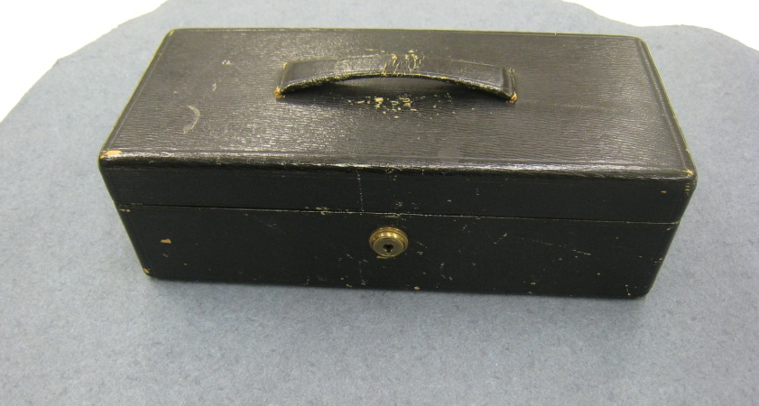
Library of Congress Holdings
Assassination – April 14, 1865
The locked leather box containing the contents of Lincoln’s pockets the night of his assassination was passed down in the family and then was donated to the Library of Congress by Lincoln’s granddaughter Mrs. Charles Isham in October 1937. The box remained unopened until the spring of 1976.

Slide 6
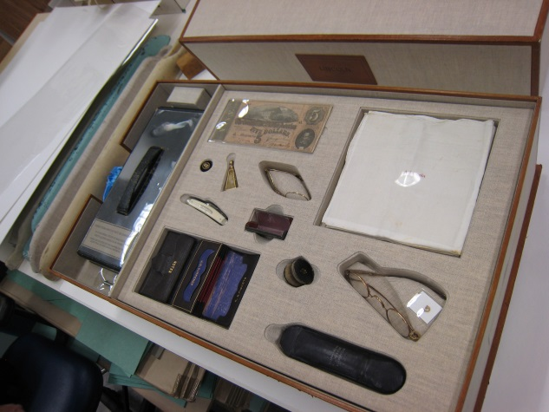
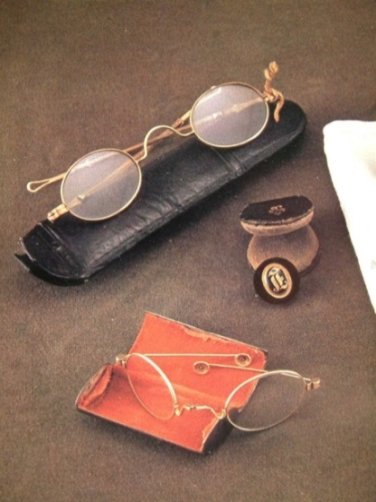
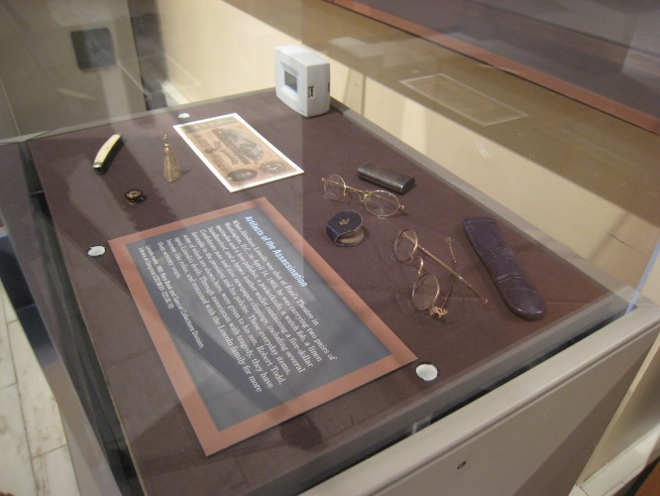
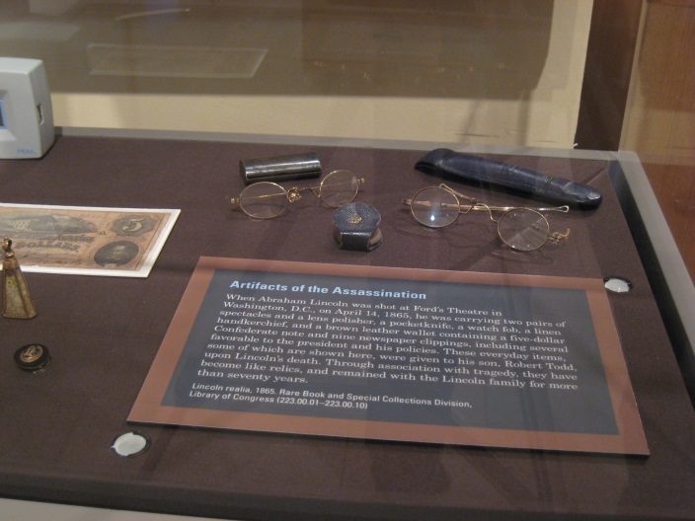
In Lincoln’s Pockets 1
Library of
Congress
Exhibition at the Newberry Library, Chicago, 2009

Slide 7
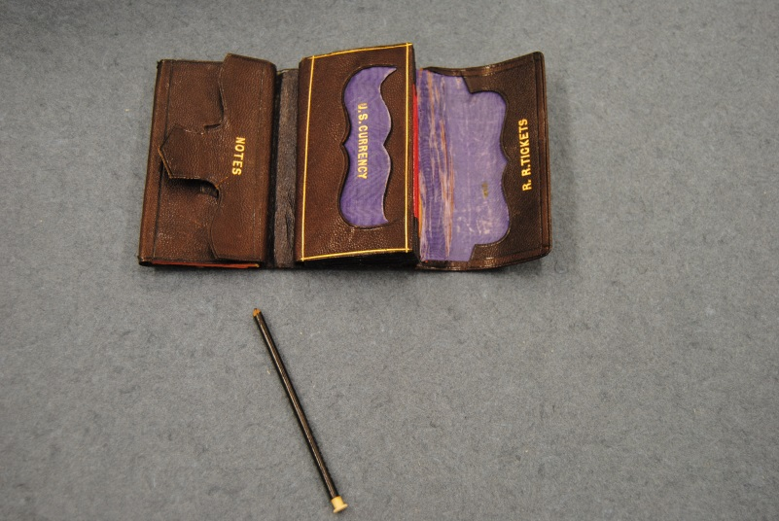
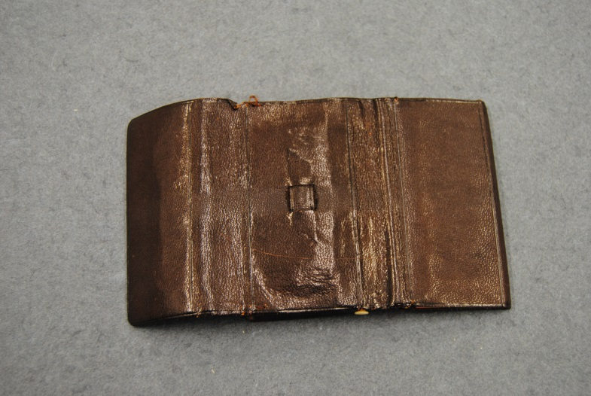
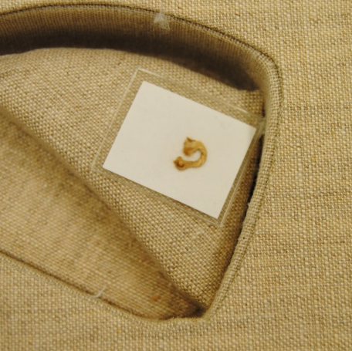
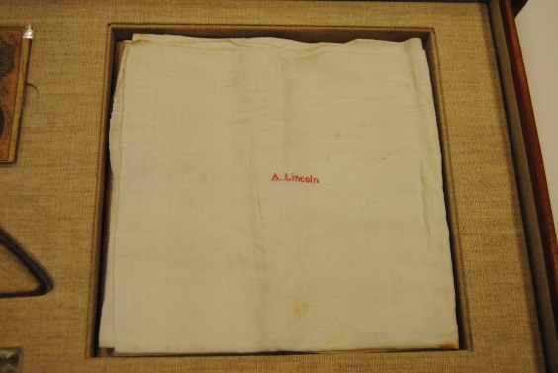
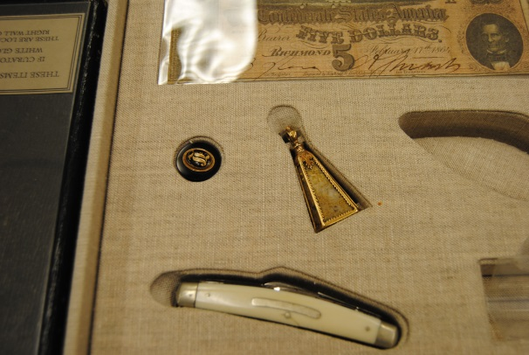
In Lincoln’s Pockets 2
Library
of
Congress

Slide 8
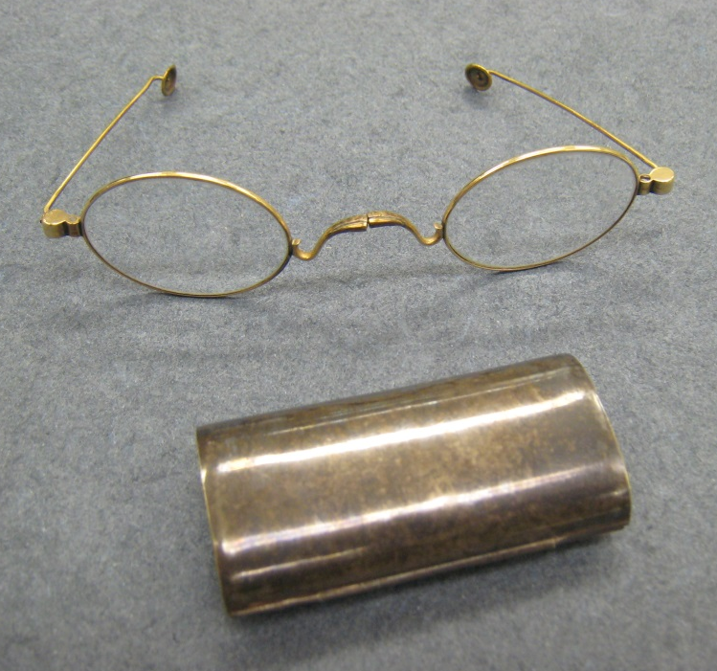
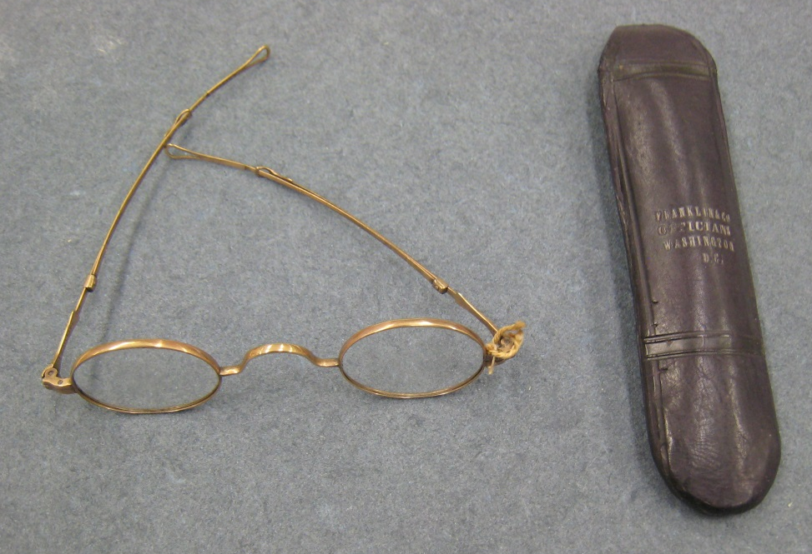
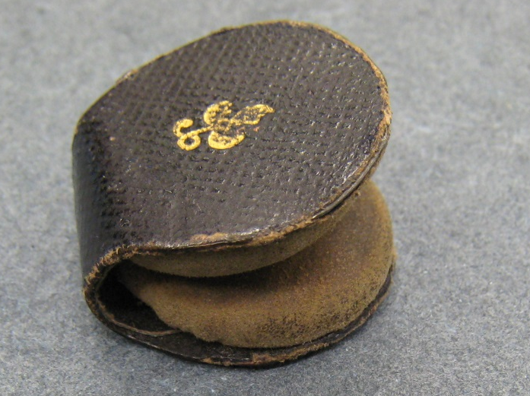
Glasses, Cases and Cleaner
Library
of
Congress

Slide 9
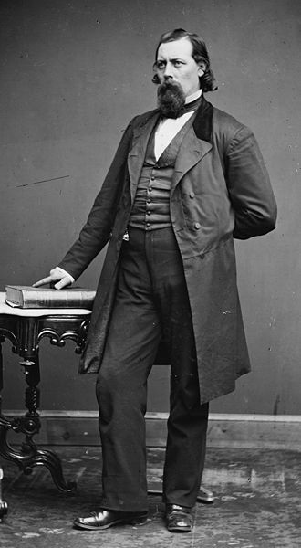
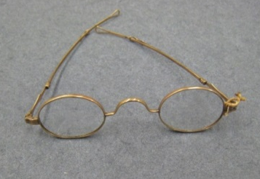
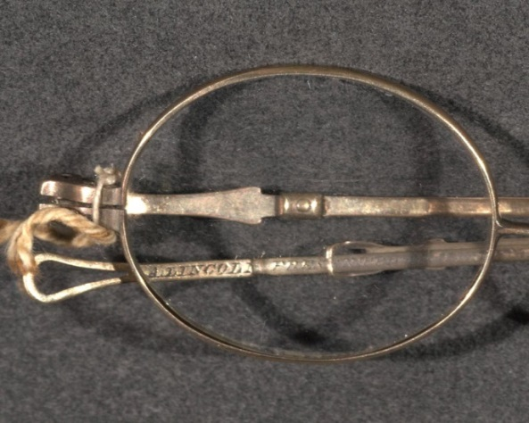
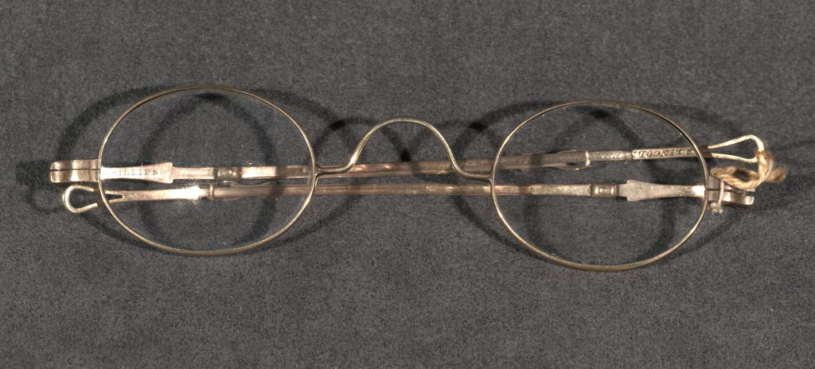
Presentation Glasses
Personal gift of Ward Lamon
Inscription “A Lincoln, Presented by Ward H. Lamon”.
“J. Phillips” – Dr. John Phillips
worked in Chicago 1858-1868
When given? When hinge was broken?
Where is the case?
+1.75 ou

Slide 10
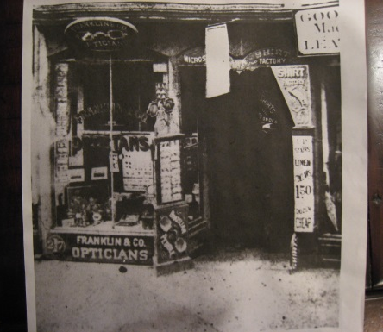
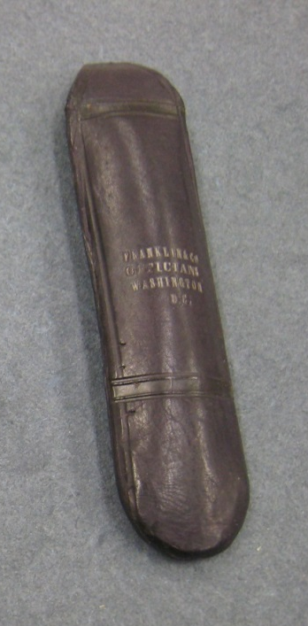
Franklin and Co Opticians Washington, DC Case
The original business of Franklin & Co was founded by Morris I. Franklin in Philadelphia in the mid-1850s. Isaac Heilprin (1827-1900) was a co-founder and in 1861 the shop moved to Washington, DC. Abraham Lincoln entered that shop on May 4, 1864 and purchased eyeglasses and a case for himself for only $2.50.
Where are the original specs?

Slide 11
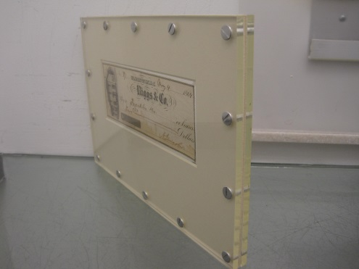
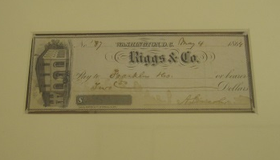
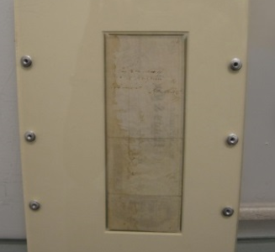
The Check
The personal check with Lincoln’s signature was never cashed and a photocopy of it was displayed for many years in the window of that Washington, DC business. An article about the check appeared in a prominent optical journal in 1933. Franklin & Co Opticians went out of business in the 1970s and the check itself then seemed to disappear.
Check was actually handed down thru the family and placed in a bank safe. I tracked down the family and then the two people who inherited the check.
Unfortunately in 2009 that May 4, 1864 check was auctioned at a Dec. 2010 Christie’s Sale. Believed to be the only Lincoln check that was never cashed. Too bad the Madison Funds (LOC) were not given the opportunity.

Slide 12
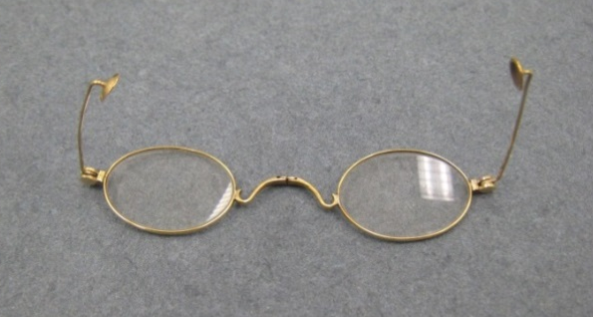
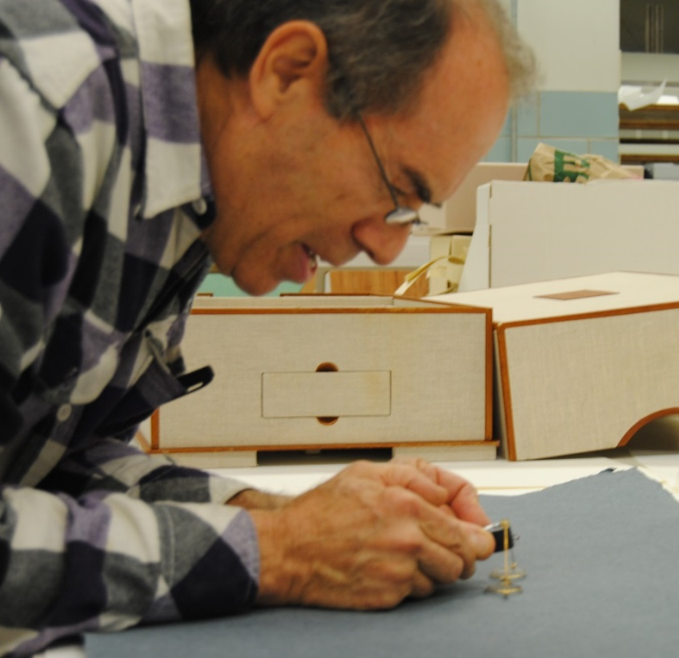
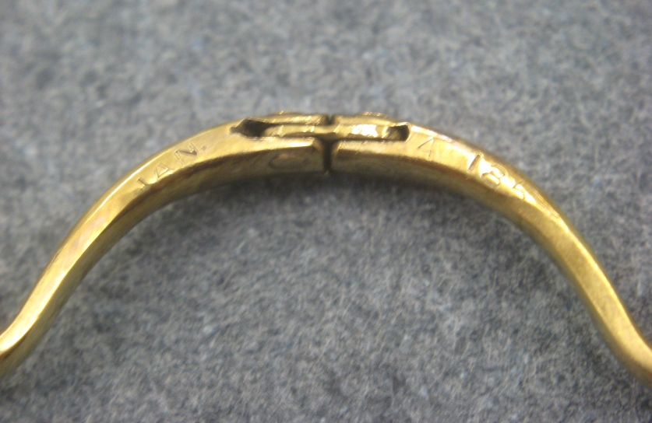
B&W specs- Exam – the back of the nose bridge previously seen by only a very small number of people
+2.00 ou
Oct 30, 2011 examination
**three others in gold are known, also with a
patent date. Then two more are in blued steel,
probably from a later time (BOA Museum).
“Jan 1859”

Slide 13

Burt & Willard Patent
“NEAT….ELEGANT….COMPACT….MOST CONVENIENT AND SNUGLY PORTABLE EVER BEFORE INVENTED”
Jan 4, 1859, Patent #22485
“So constructed as to allow the folding together of the glass frame and the short temple bows and cups, forming one of the most convenient and snugly portable spectacles for use and for the pocket ever before invented or used”.
John Burt of Hartford, Conn. and William W. Willard of Syracuse, NY.
These glasses were sold from 1860 to as late as 1867.
***The Burt & Willard patented glasses appear to be associated with Lincoln beginning as early as April 1862, a fact now confirmed thanks to the tremendous research efforts of Alan McBrayer.

Slide 14
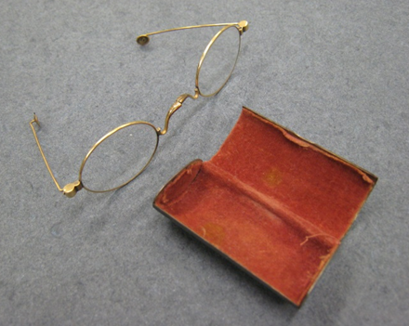

Case for the Burt & Willard
The tiny silver case with patina appears original to Lincoln’s folding gold glasses. There are no marking on this Library of Congress case. Only one other similar case is known and it is held at the BOA Museum in London. The term “Registered” can be seen on one end of that silver case. Interesting here is the fact that the term “registered” does not generally appear on American made products, and it is believed that this case was made after the Lincoln case.

Slide 15
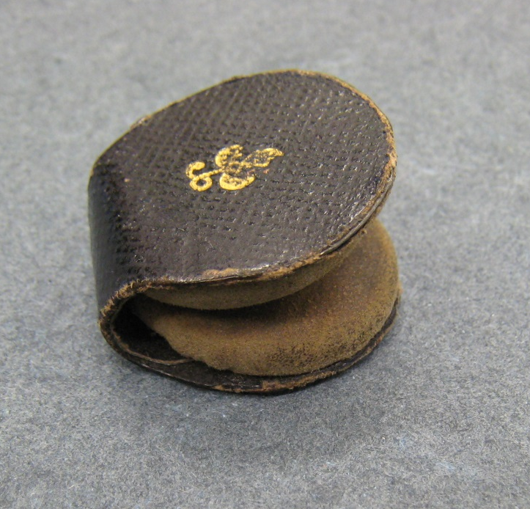
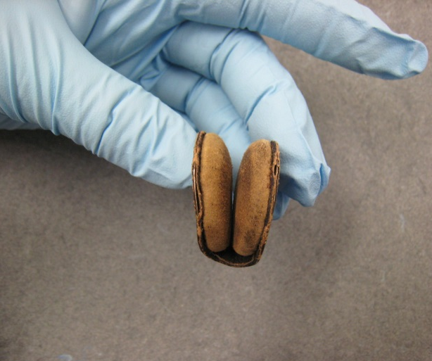
Glass Lens Cleaner
Unique, a similar example has never been seen
Fleur-di-lis symbol
Two soft cushion pads

Slide 16
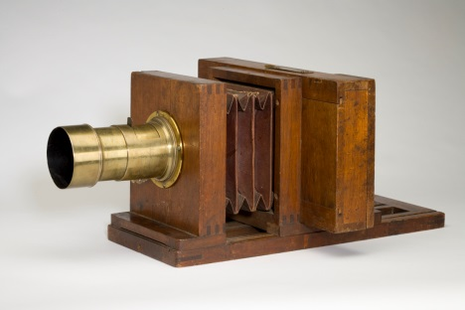
Photographs
Lincoln sat for 31 camera men on 61 different occasions.
There are evidently 119 photographs in all.
Alexander Gardner (1821-1882) took thirty
Matthew Brady (1822-1896) took eleven.
Brady brought Gardner, a Scotchman, over to America in 1856.
Gardner started in the Brady Studio, in charge of it from 1858-1863.
Brady’s Studio was on the corner of Pennsylvania and Seventh Street in Washington, DC.
Gardner then established his own studio on Seventh Street.
Lincoln then became Gardner’s first client in his new studio.
At that time the Lewis camera was the typical studio camera.
George Eastman House

Slide 17
Photographs
The earliest known photograph of Lincoln is a daguerreotype taken in 1846. Several photos in 1860 show him with a black spectacle’s cord going down across the front of his shirt. Only a single close-up image shows him actually wearing spectacles but several do show him holding those same eyeglasses. Most all of the later photos of Lincoln are actually cartes-de-visite. Besides the eyeglasses and the earlier cord, the only other personal ornament worn by Lincoln was a heavy hair-thin braided gold watch chain.
Currently the largest group of photos exists in the Lloyd Ostendorf Collection in Indiana. Currently this is stored at the Allen County Public Library in Fort Wayne under the direction of Cindy VanHorn. The collection, however, is owned by the Indiana State Museum.

Slide 18
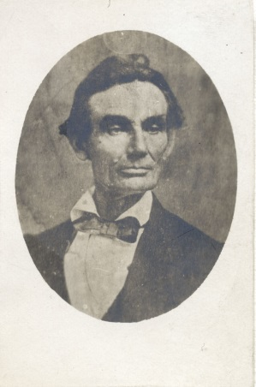
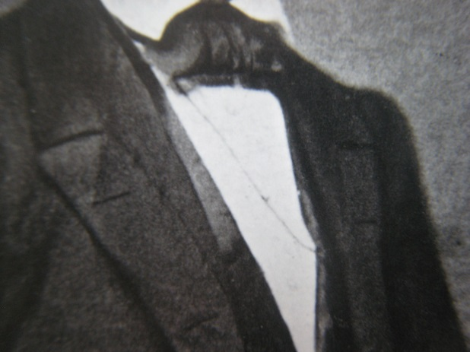
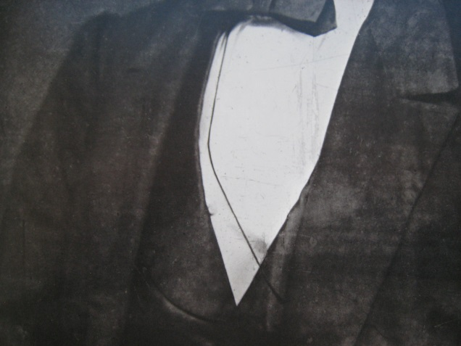
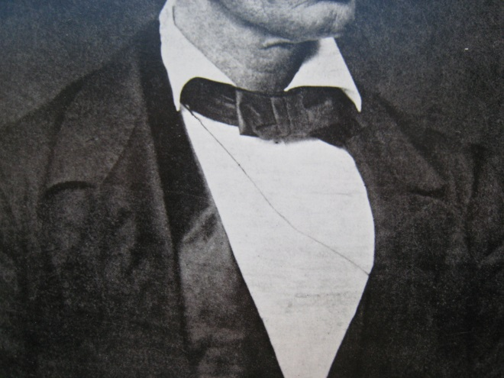
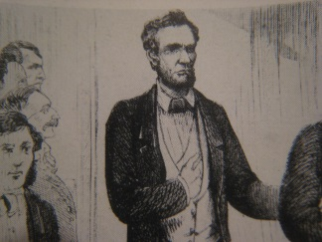
A black eyeglasses cord appears in some photos
O-012: Only original tintype of Lincoln, unknown photographer, 1858 O-017: Photograph by Matthew Brady - Feb 27, 1860. O-019: Photograph (probably ambrotype) by Edward A Barnwell, Decatur, IL, - May 9, 1860. O-021: Photograph by William Marsh – Springfield, IL. - May 20, 1860. Both hands are resting on his lap. Two different poses were taken at the same photograph session. In O-020 (Ambrotype by Preston Butler) Lincoln's left forearm and hand are resting on a table. Here in O-021, both hands are resting on his lap. O-022 is very similar. O-026: Photograph by Alexander Hesler, Springfield, IL. – June 3, 1860. O-027: Photograph by Alexander Hesler, Springfield, IL. – June 3, 1860
0-012
0-017
0-019
0-027
Harper’s
Weekley

Slide 19
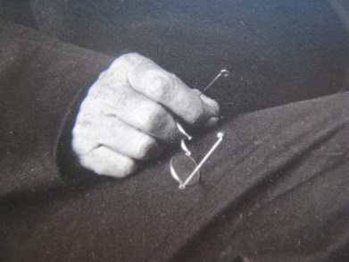
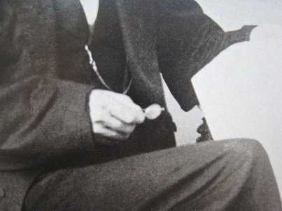
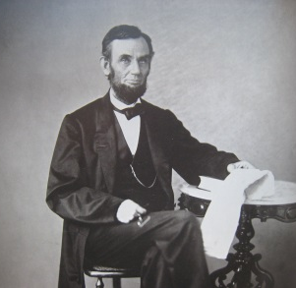
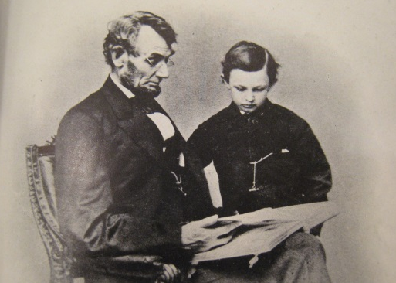
Burt & Willard glasses appear in some photos
O-070, Photograph by Alexander Gardner, in his new gallery, Washington DC, August 9, 1863 O-071, Photograph by Alexander Gardner – Washington DC, August 9, 1863 O-072, Photograph by Alexander Gardner – Washington DC, August 9, 1863 O-078, Photograph by Alexander Gardner – Washington DC, November 8, 1863 O-093, Photograph by Anthony Berger, in Matthew Brady's Gallery, Washington, DC,
Feb 9, 1864 - seen with his youngest son Tad (1853-1871), Lincoln is actually wearing the Burt and Willard spectacles
0-071
0-072
0-070
0-078
0-093
It is my opinion these were Lincoln’s favorite

Slide 20
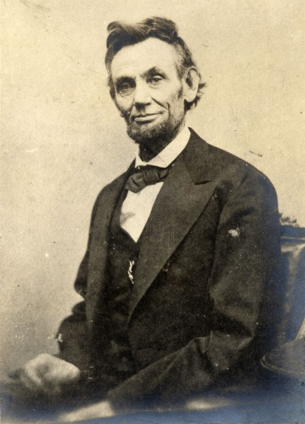
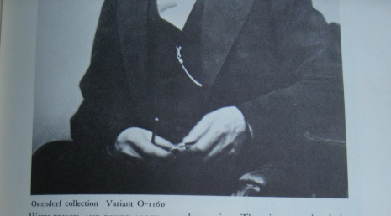
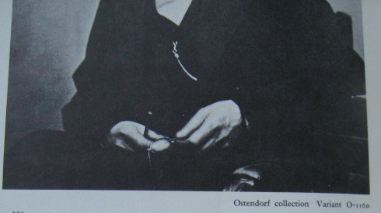
Burt & Willard glasses appear in other photos
O-116, Photograph by Alexander Gardner – Washington DC, Monday, February 5, 1865 Lincoln evidently moved his hands and fingers nervously during the sitting so his little spectacles are blurred. (Remember also that the speed of those very early cameras was quite slow. Essentially it was the time to uncover and then recover the lens by removing and then replacing the cap to the lens, by hand.) O-116 VARIANTS (RETOUCHED) – one version shows a pencil and glasses while another version shows a pencil and pocket knife. Realize that when an image was blurred an artist could be hired by the photographer to retouch or add to the scene to make it clear.
BOTH RETOUCHED VARIANTS APPEAR IN SEVERAL PROMINENT BOOKS
Retouched-
Pencil and
glasses
Variant x 2
Retouched-
Pencil and
Pocket knife
0-116
0-117

Slide 21
Discussion and Conclusions
DISCUSSION - The architecture of Lincoln’s Burt & Willard spectacles with their short thin side arms and cupped finial endings must be understood in order to determine if the retouched photos make any sense. Why would Lincoln hold a pencil during this photographic session - especially if his pencil was normally housed in the small slot in the back of his own wallet? Then too where is this wallet and why has that pencil NEVER EVER been seen before in any other photo sessions? I do not believe his pencil was in his hands during this sitting. The artist who retouched the original created/added a vertical pencil and also an eyeglass frame with a curl sidearm pointing downwards. But glasses with a curl sidearm did not even at that time. Instead, I believe Lincoln was again holding only his favorite little pair with the sidearm pointing upwards. To the knowledgeable observer the blurred shadow in all four O-116 images is that of the cupped finial atop the vertically positioned sidearm. Those concave holding cups are known to be a prominent part of the Jan 4, 1859 patent #22,485. In the same sitting, I believe O-117 also shows those same glasses, but they appear even more blurred and with the sides mostly folded closed towards the nose bridge.
CONCLUSION -In my opinion, the retouched images definitely are not justified in the way they have been described up to this time. These glasses and the pencil were painted on sometime after 1865 and into the 1870s. The original untouched photographic plates show a blur – therefore the added specs with curl sides and the added pencil are a “painted fraud” of the 1870's. The pencil was quite thick and black and would not have created this appearance. Notice that the base of Lincoln’s right thumb can be easily seen and therefore nothing thick and black (like his own pencil) could have rested vertically in his hands. ONLY the very thin sides of the Burt and Willard spectacles appear since they are held by Lincoln’s fingers in all the O-116 photos, in my opinion. Also remember these particular patent glasses had the ability to fold in the middle of the bridge, providing even more possibilities for how they might show up in the blurred images. O-117, Photograph by Alexander Gardner – Washington DC, Monday, February 5, 1865 most probably the Burt & Willard glasses are between his hands and the cupped finials seem apparent, but are blurred yet again, in the nearly closed position.

Slide 22
Just How Rare are the B & W specs?
1. Rivet Spectacles– 14th – 16th century: 27 known – mostly just fragments. 2. Masterpiece Spectacles - German, early 17th century > early 18th century: about 30 pairs known in a dated simple wooden box. 3. Leather-Framed Spectacles - early 16th century >18th century: about 125 in collections then another 240 from the 1583 Gnalic shipwreck off the coast of Croatia, now in the Biograd Museum. 4. Adam’s Patent Spectacles – English, 1797-99: 9 known. 5. Gondola Glass from Venice – circa 1800: 7 known. 6. Goldoni Spectacles (Venetian) – late 18th century: about a dozen known 7. Hat Spectacles – 1870-1900: about a dozen known 8. Waldstein Spectacles (all glass) - 1830s: over a half dozen known 9. Spina Frontalis (Cap Spectacles) - 17th > 18th century: about a dozen known 10. Scarlett Temple Spectacles (spiral finials) - about 1725 > very early 19th century: about a half dozen known. 11. Slit Bridge Nose Spectacles – 18th century: more than two dozen known. 12. Addison Smith - 4 lens variety – based upon first spectacles patent #1389 in 1783, (the only problem – there is no convincing proof that the actual patent involved flip-up lenses) – perhaps three dozen various styles are known. 13. John McAllister Sr. solid gold, circa 1815-1820 – fewer than five known. 14. Burt and Willard Spectacles – 1859 patent: (only four known in gold including Lincoln’s) and then two others in blued-steel at the BOA Museum

Slide 23
Ranking
The Burt and Willard specs at the LOC should now be ranked alongside the greatest, most famous vision aids in the world (like Thomas Jefferson’s self-devised eyeglasses -1806), George Washington’s four lens spectacles, Napoleon’s telescope, Ben Franklin’s bifocals [if they are ever located], and even Galileo’s two telescopes.

Slide 24

Conclusions – the Library of Congress is so very fortunate because……
Ward H. Lamon engraved glasses – with their history
Franklin & Co Opticans’ case – with its history
Case for Burt & Willard glasses – with its history
Burt and Willard (1859 patent) glasses – DESERVE MORE RECOGNITION in my opinion
the only eyeglasses with which Abe was photographed (on three different occasions) between 1863 and 1865 leading the presenter to conclude these were Lincoln’s most favorite glasses of all. They are one of only four known similar examples.
These are a very rare world-class optical treasure, one of the most famous and important pair of eyeglasses ever created in the past 700+ years.

Slide 25
Finally
Thank you.
If you wish to learn more about this and other topics go to www.antiquespectacles.com.
Enjoy what you find there.

