Slide 1
ANCIENT ROMAN SESTERTIUS COIN OF TITUS AS CAESAR, UNDER VESPASIAN, 72 AD
PEDIGREED TO GONZAGA COLLECTION OF MANTUA
16th Century

Slide 2
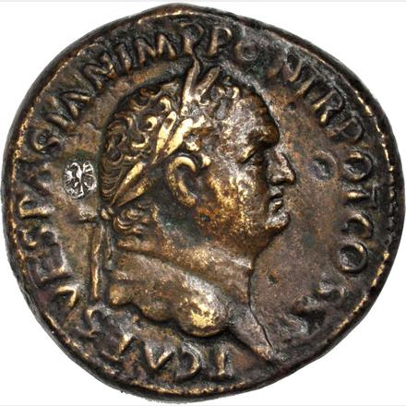
Obverse: T CAES VESPASIAN
IMP PPON TRPOT COS II
Bust of Titus, to left of bust, silver Gonzaga countermark (Eagle)

Slide 3
Titus, as Caesar under Vespasian, 69-79 CE,
AE Sestertius, 32 mm, 24.80 g axis 6 hr, 72 CE
Obv.: T CAES VESPASIAN IMP PON TR POT COS II: Hd. of Titus, r.;
on left of bust, silver inlay with Gonzaga Collection eagle countermark
Rev.: IVDAEA CAPTA / S.C: Palm tree, Titus stg. r. with spear and parazonium, mourning Jewess seated. r.
EX: Stacks/Bowers Auction B, lot 2098, Michael Druck Collection, 2017 Jan. 13;
Ex. Jacques Schulman Auction 235, lot 85, 1961 June; Ex. Glendening Auction, Ryan Sale, lot 2381,
1952 April
Ex. Leonello d’Este Collection of Gonzaga family of Mantua
REF.: RIC II-2 422, RIC 608, C 113, Hendin 1523

Slide 4
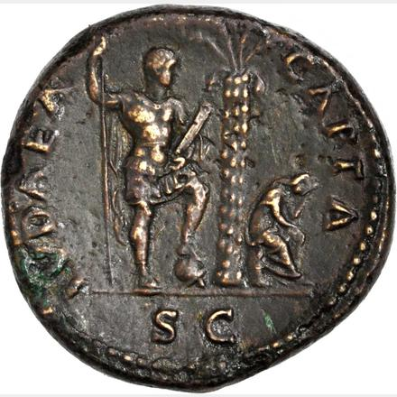
Reverse: IVDAEA CAPTA / SC
Palm tree, on l., Titus standing
holding spear and parazonium;
on right weeping seated Jewess

Slide 5
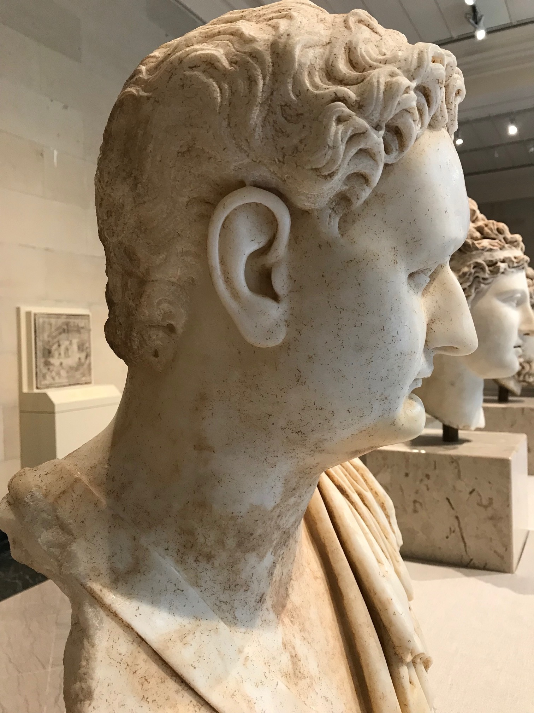
Bust of Domitian, 81-96 AD, younger brother of Titus, 79-81 AD
in TMA collection

Slide 6
