Slide 1
OTTO WICHTERLE 1913-1998
Jay M. Galst, MD, FACS
Clinical Professor: Department of Ophthalmology
Mount Sinai Icahn School of Medicine
Senior Attending Surgeon
New York Eye and Ear Infirmary
New York, NY

Slide 2
OTTO WICHTERLE 1913-1998 Father of the Soft Contact Lens

Slide 3
FINANCIAL DISCLOSURE
Conflicts of interest
None regarding this presentation

Slide 4
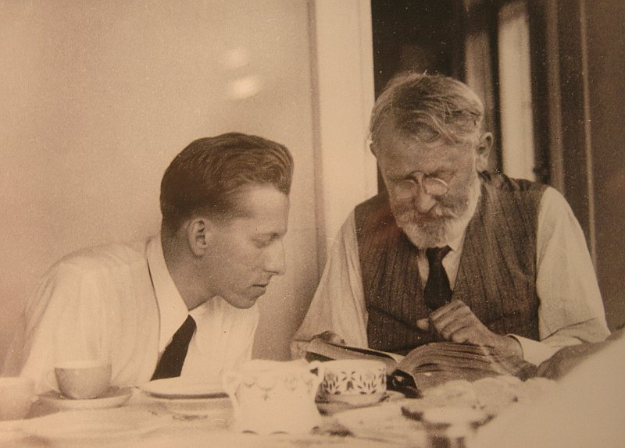
OTTO WICHTERLE
Born, 1913 in Prostejov, Moravia
Chemistry degree from Czech Technical Univ., Prague in 1936
PhD in Organic Polymer Chemistry in 1939, under Emil Votocek
Forced to leave the Czech Technical University because of the German Occupation

Slide 5
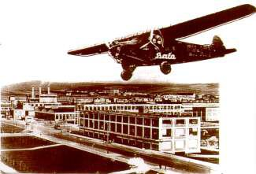
OTTO WICHTERLE
Found a research position at the Bata Shoe Co., Zlin, Cz.
Discovered Silon in 1941
Imprisoned by the Gestapo in 1942
Post WWII Silon was the Iron Curtin Nylon

Slide 6
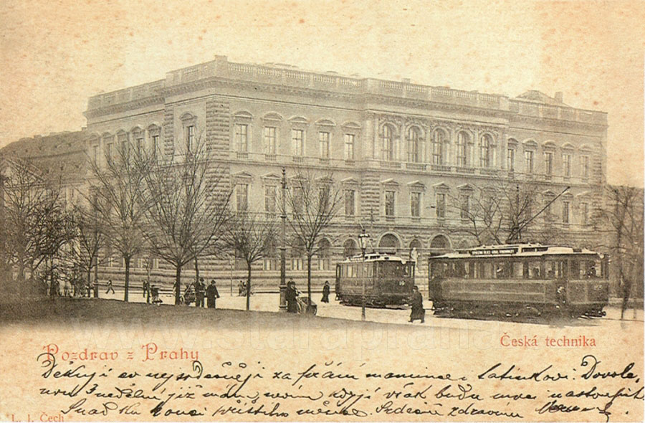

OTTO WICHTERLE ERLE
Returned to Czech Technical University
As a faculty member
In 1949 obtained 2nd PhD on Technology of Plastics

Slide 7
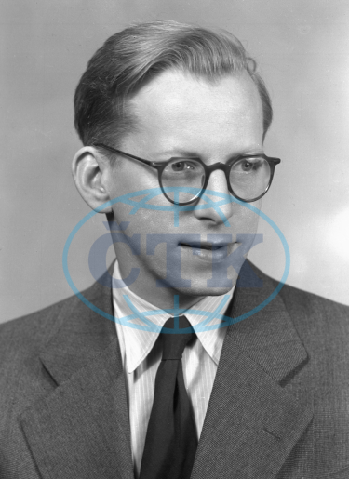
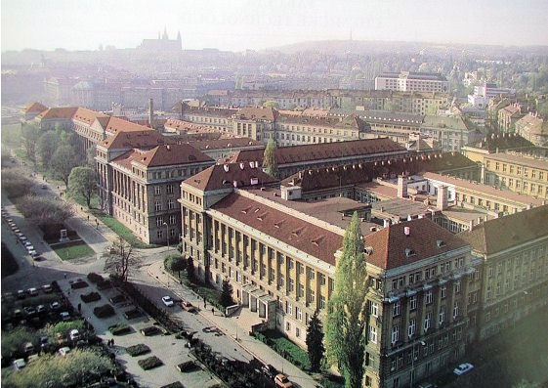

OTTO WICHTERLE ERLE
In 1952 appointed 1st Dean of Institute of Chemical Technology in Prague

Slide 8
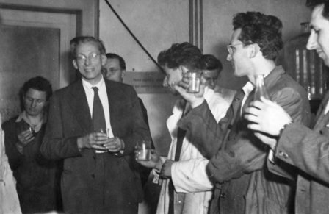
OTTO WICHTERLE ERLE
At ICT prepared pHEMA with Drahoslav Lim
A novel transparent polymer that was a 40% water colloidal gel
In 1957 produced soft gel contact lenses in a closed cast mold technique
Had problems with lens edge irregularities

Slide 9
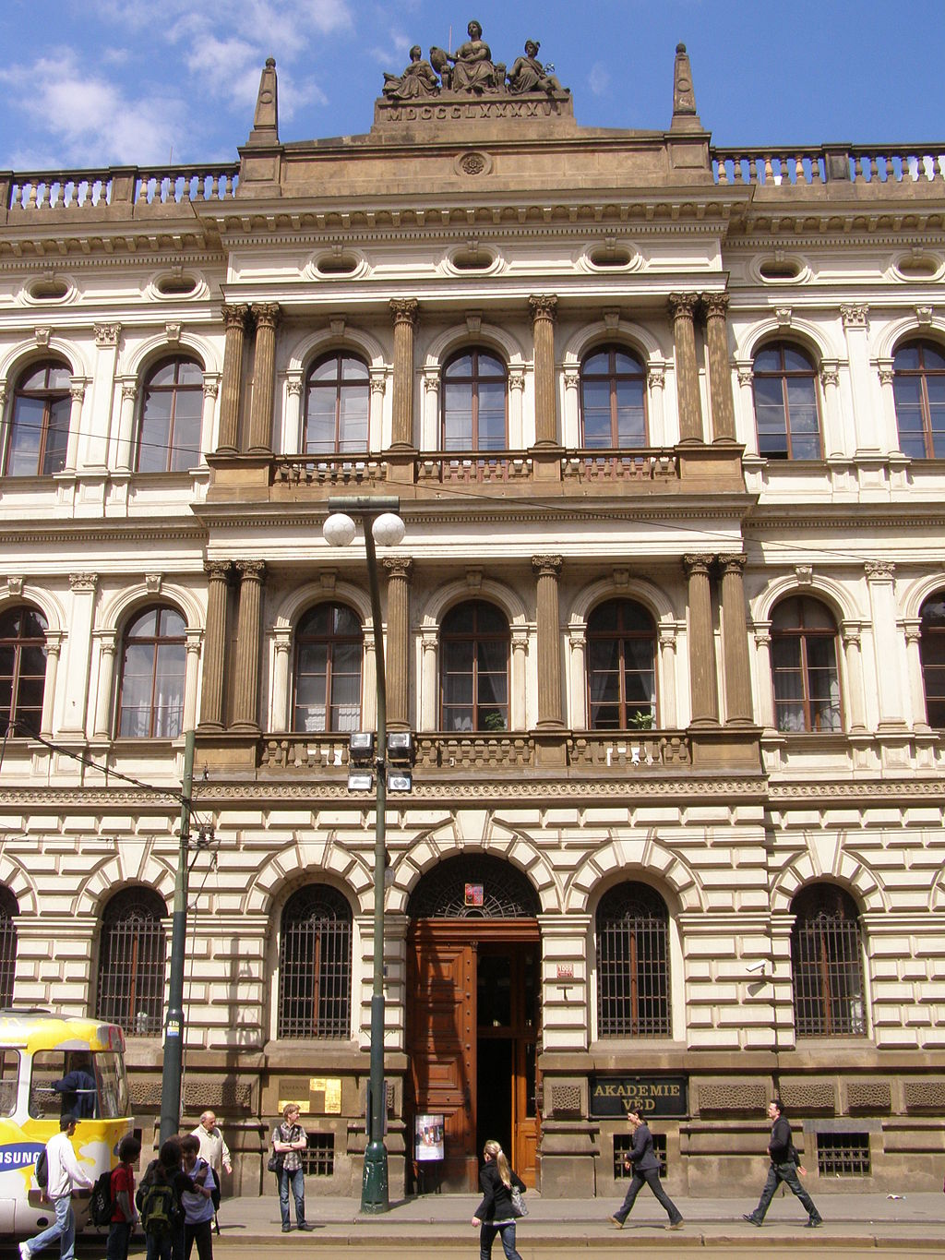
OTTO WICHTERLE ERLE
Forced to resign from the University in 1958
Communist regime considered him politically unreliable
Later in 1958 was able to establish the Institute of Macromolecular Chemistry under the Academy of Sciences

Slide 10
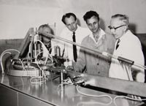
OTTO WICHTERLE ERLE
Published with D. Lim a seminal paper in
Nature January, 1960 on
Hydrophilic gels based on
pHEMA
Proposed their use in soft contact lenses and other biocompatible products

Slide 11
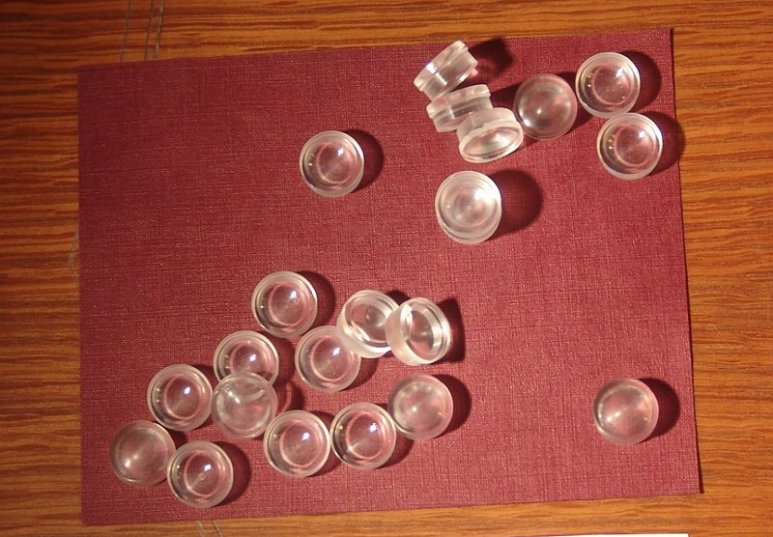
OTTO WICHTERLE ERLE
In 1961 proposed spin casting to overcome the lens edge irregularities
Involved using open molds spun as a centrifuge
Lens shape occurred during the spinning
Mold defined the front surface of the lens

Slide 12
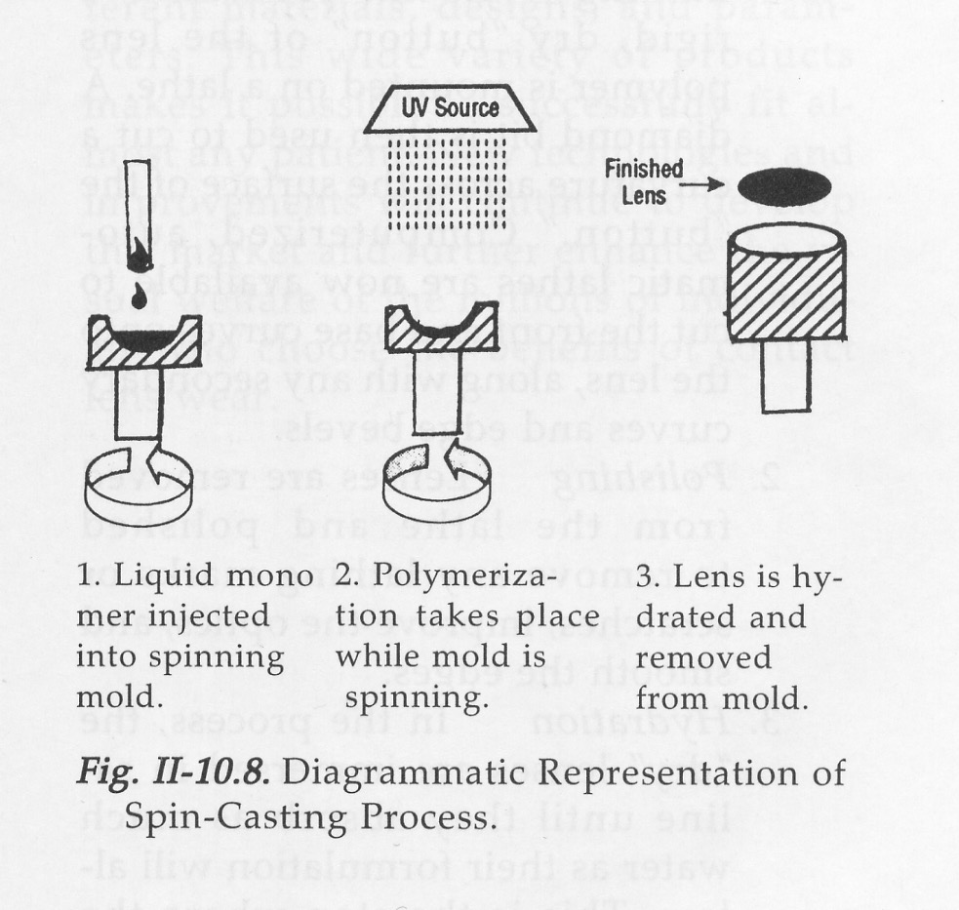
OTTO WICHTERLE ERLE
Rotational velocity,
Surface tension, and
Gravity combine to define the back surface of the lens
Lens was produced in a hydrated state

Slide 13
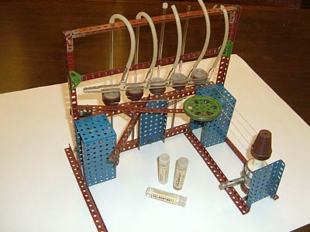
OTTO WICHTERLE ERLE
Xmas Eve 1961, using his son’s Merkur erector set,
glass molds, & a bicycle
generator,
a spin casting device was constructed in his home kitchen
X-mas Day 1961
he spun cast four soft lenses with smooth regular edges

Slide 14
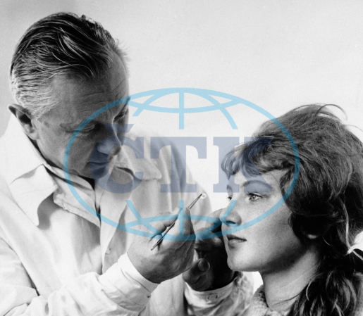
OTTO WICHTERLE ERLE
He soaked the lenses in normal saline overnight
The next day brought the lenses to Dr. Max Dreifus of the 2nd Ophth. Clinic in Prague
Tested them on healthy eyes

Slide 15
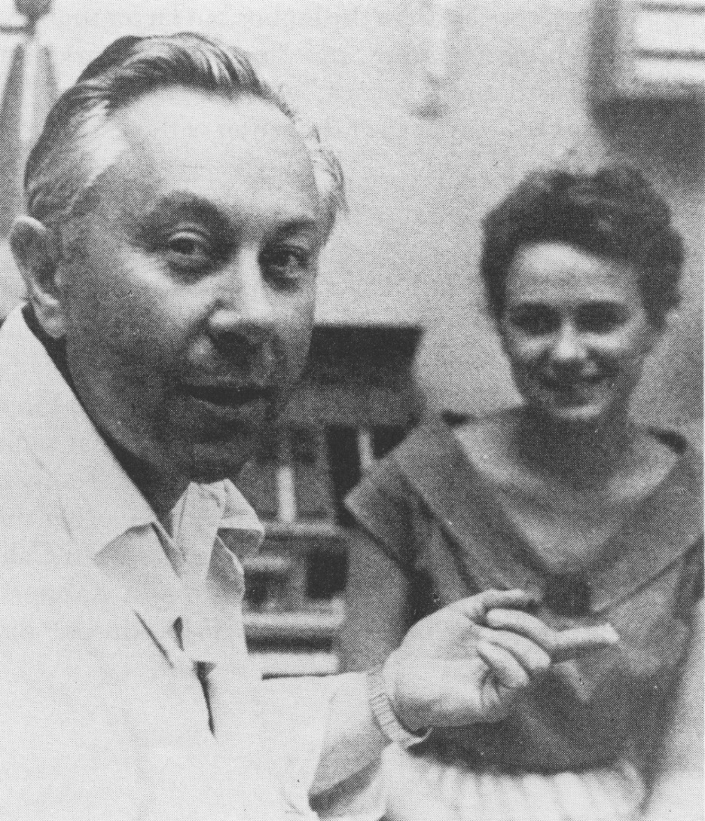
OTTO WICHTERLE ERLE
Found that spin cast lenses
Did not irritate healthy eyes
Patients tolerated the lenses well and felt they were comfortable
With over-refraction achieved excellent visual acuity

Slide 16
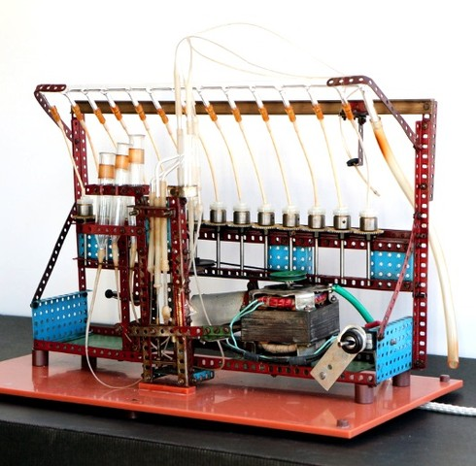
OTTO WICHTERLE ERLE
New Years Eve 1961, built a larger device with 13 spindles
Bicycle generator was not strong enough
So used motor from his phonograph turntable to provide a stronger motor

Slide 17
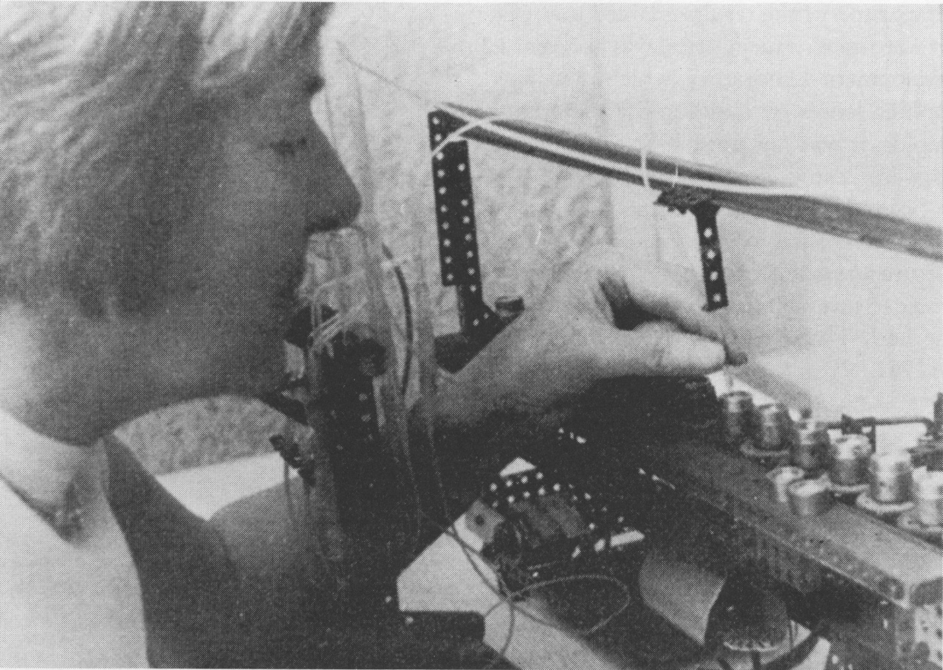
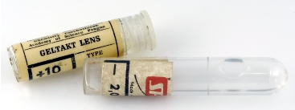
OTTO WICHTERLE ERLE
In the first week of January, 1962 he and his wife, Lidia, produced several hundred lenses
In the first four months of 1962 produced 5,500 lenses

Slide 18
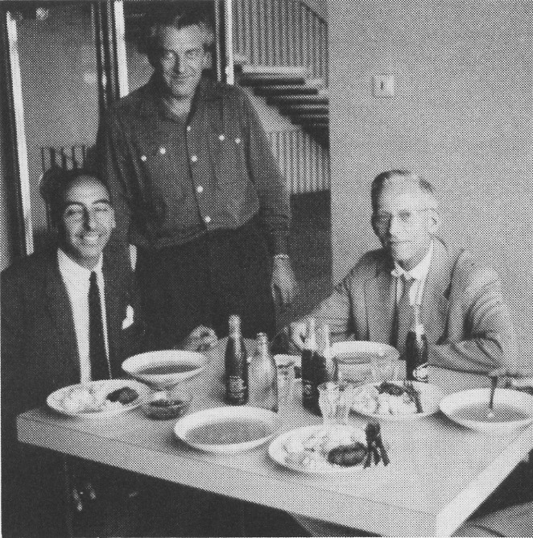
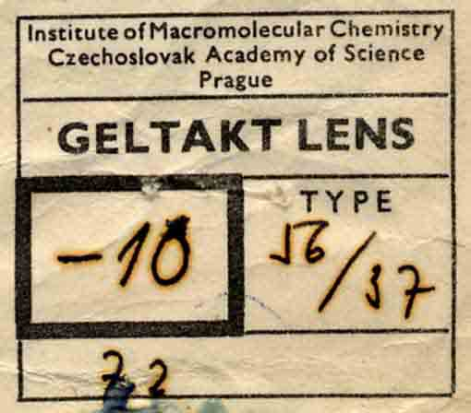
OTTO WICHTERLE ERLE
In 1963 patented the material &
the manufacturing process for
soft contact lenses
Entrepreneurs like Dr. Robert Morrison went to Prague and did collaborative clinical research
Morrison tried to buy the patent rights from the Czechoslovakian
government

Slide 19
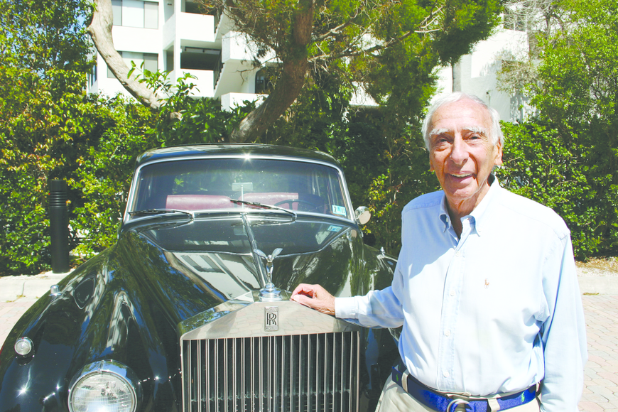
OTTO WICHTERLE ERLE
In 1964 the patent rights were sold to both Morrison and NPDC, which was owned by American businessmen M. Pollack & J. Feldman
Sold to them as equal partners for $330,000.
Wichterle received 1/10 of 1% of that payment, about $330.

Slide 20
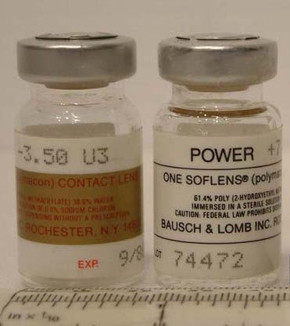
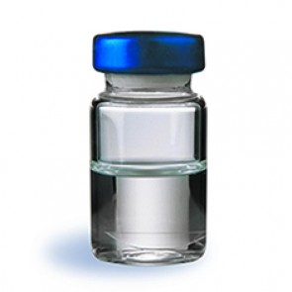
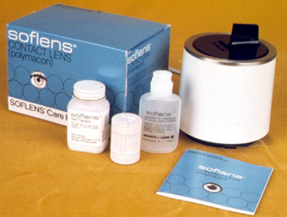
OTTO WICHTERLE ERLE
Morrison & NPDC were hostile partners & eventually NPDC agreed to buy out Morrison
It was not until NPDC made a deal with Bausch & Lomb in 1966 for $3 Million that Morrison was finally paid
After FDA approval in 1971, Bausch & Lomb was able to introduce the Soflens to the USA market

Slide 21
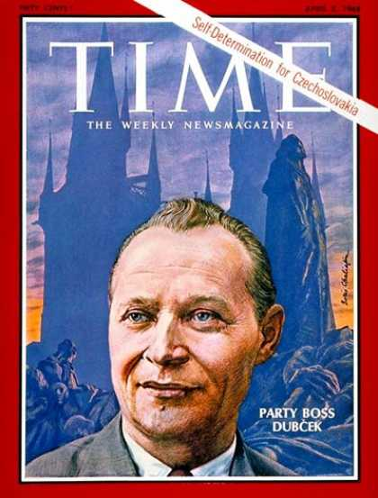
OTTO WICHTERLE ERLE
In 1968 Wichterle supported
Alexander Dubcek and the
Prague Spring movement

Slide 22

OTTO WICHTERLE ERLE
After the Soviet tanks rolled into Prague
Wichterle was dismissed
from the Institute of Macromolecular Chemistry
And barred from teaching
and international scientific communications

Slide 23
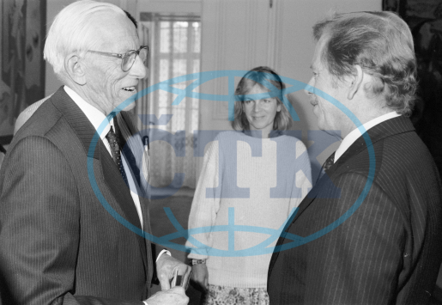
OTTO WICHTERLE ERLE
In 1989, active in the
non-violent Velvet Revolution
Elected president of the
Czechoslovak Academy of Science
Under the government of
Vaclav Havel

Slide 24
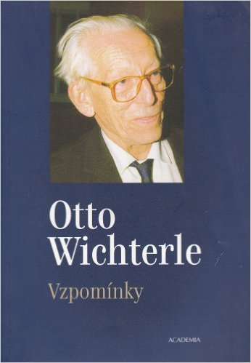
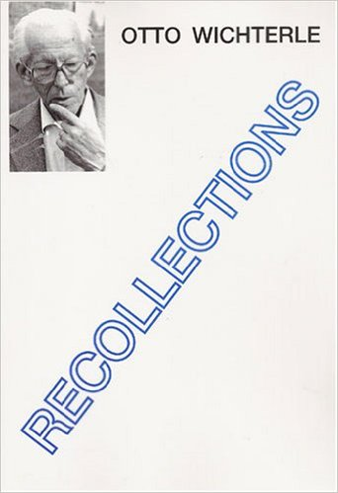
OTTO WICHTERLE ERLE
In 1992 his book
Vzpominky or
Recollections
was published

Slide 25
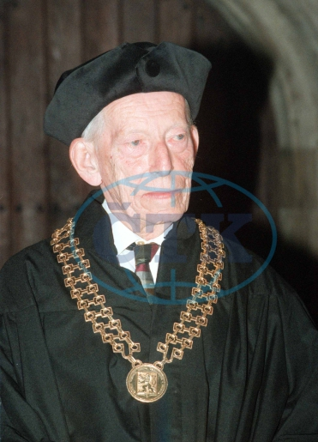
OTTO WICHTERLE 1913-1998RLE
In 1993
He became 1st
President of Czech Republic’s Academy of Science
Received from Charles University
Honorary Doctorate degree
Published over 100 journal articles
Held over 150 Patents
Asteroid (#3899) was named after him

Slide 26
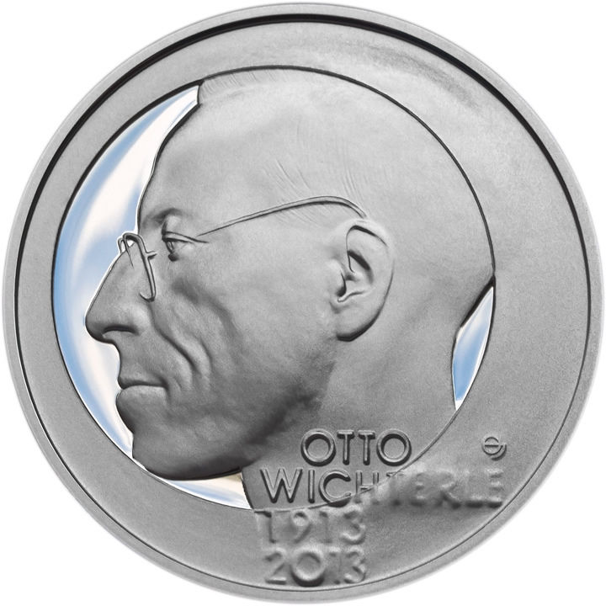
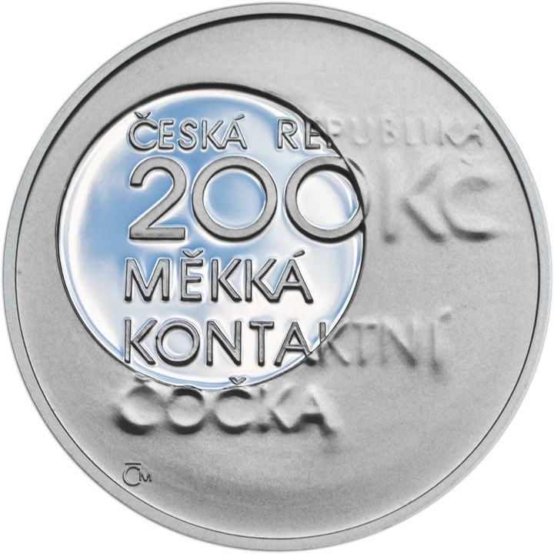
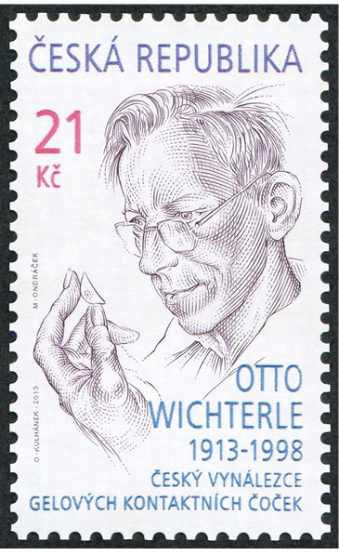
OTTO WICHTERLE 1913-1998LE
In 2013, for the centennial of his birth, the Czech Republic honored him with a silver commemorative coin, and a postage stamp

Slide 27
OTTO WICHTERLE 1913-1998LE
2013 Czech Republic 200 korun silver coin, 31 mm
By Josef Oplistil

Slide 28
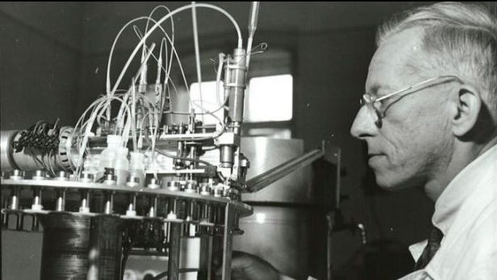
OTTO WICHTERLE 1913-1998ERLE
2013 Czech Republic 200 korun silver coin obverse

Slide 29
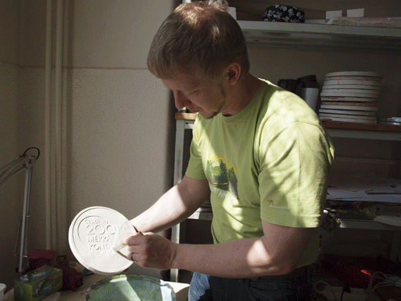
OTTO WICHTERLE 1913-1998RLE
2013 Czech Republic 200 korun silver coin reverse

Slide 30
OTTO WICHTERLE 1913-1998ERLE
2013 Czech Republic 21 korun postage stamp

Slide 31
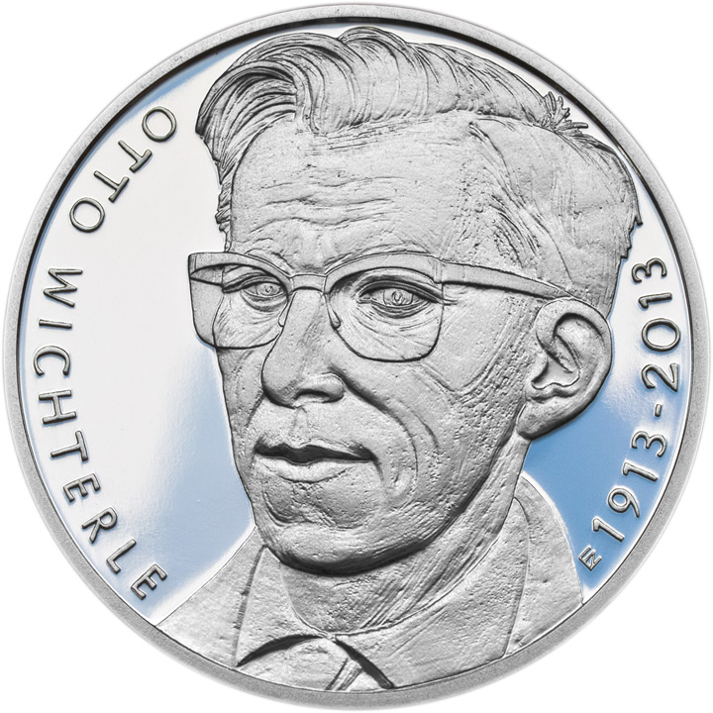
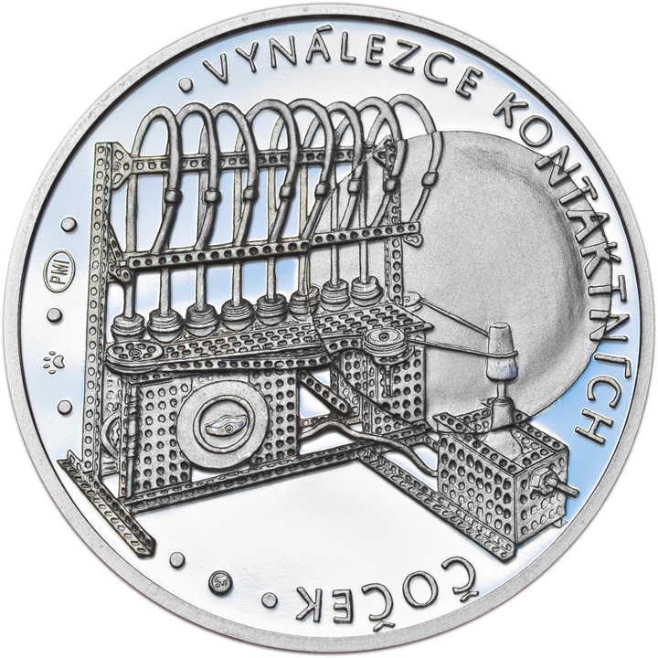
OTTO WICHTERLE 1913-1998ERLE
2013 Czech Republic Silver Commemorative Medal
By Zbynek Fojtu

Slide 32
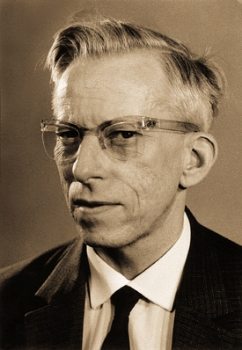
OTTO WICHTERLE 1913-1998 ERLE
2013 Czech Republic 37 mm silver medal obverse

Slide 33
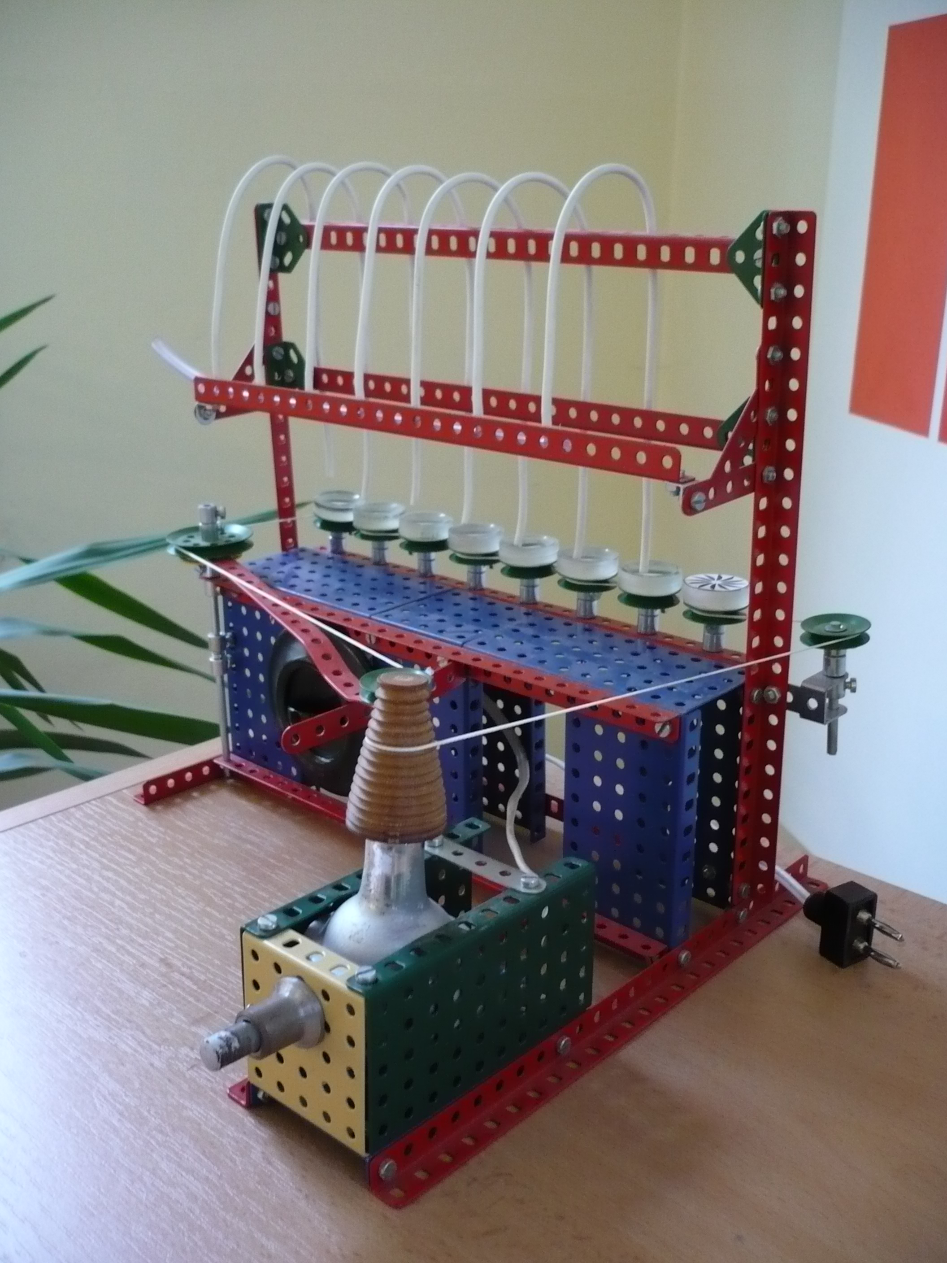
OTTO WICHTERLE 1913-1998ERLE
2013 Czech Republic 37 mm silver medal reverse

Slide 34
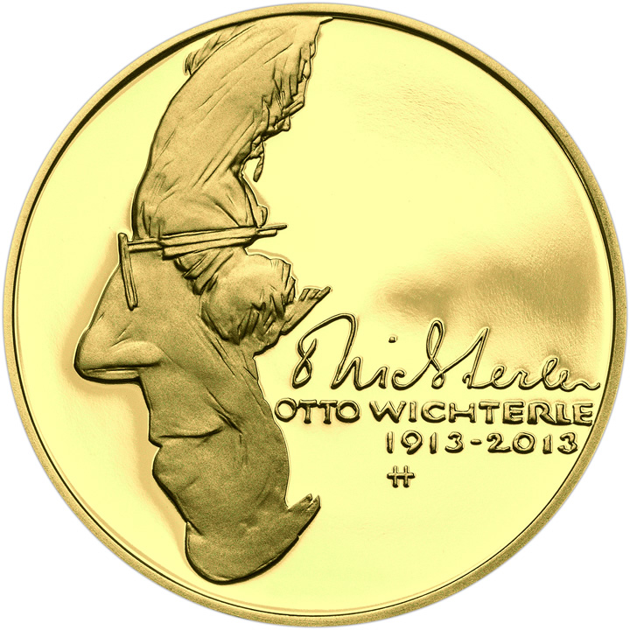
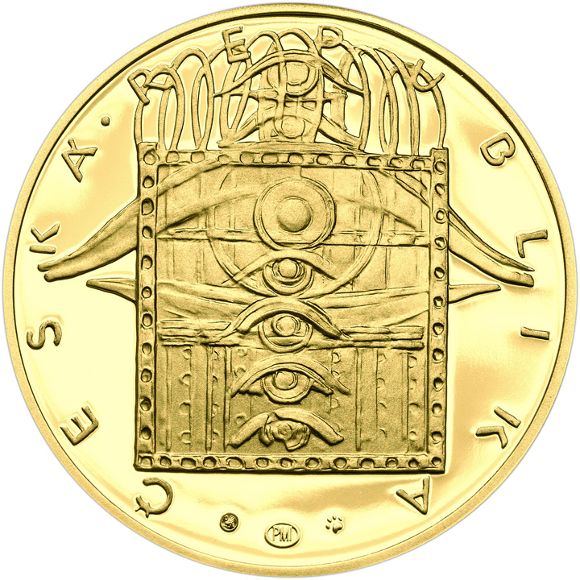
OTTO WICHTERLE 1913-1998ERLE
2013 Czech Republic gold coin proposal by Jiri Harcuba

Slide 35
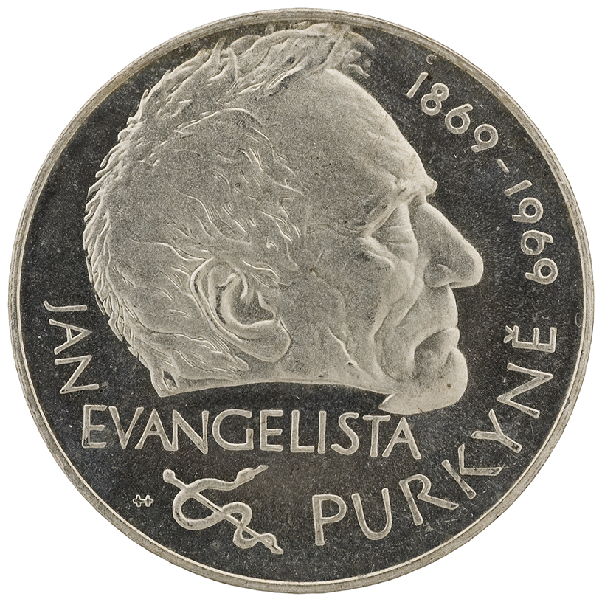
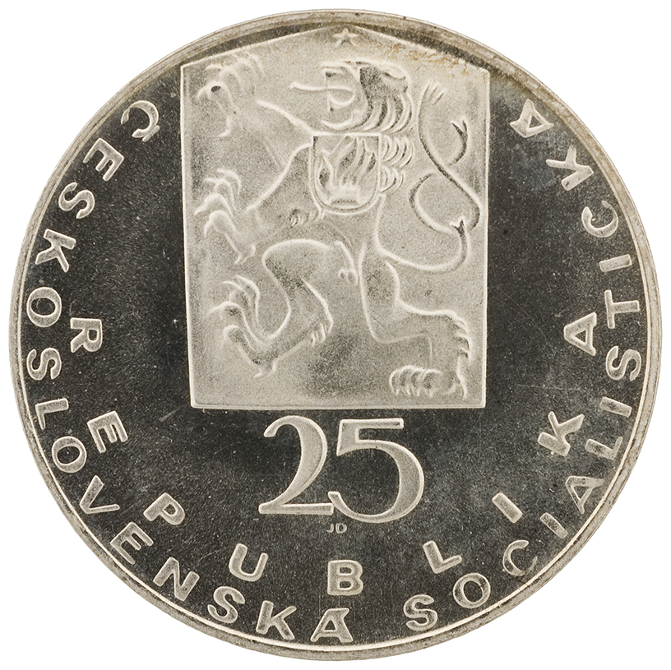
OTTO WICHTERLE 1913-1998ERLE
1969 Czechoslovakia 25 korun silver coin of Purkinje
by Jiri Harcuba

Slide 36
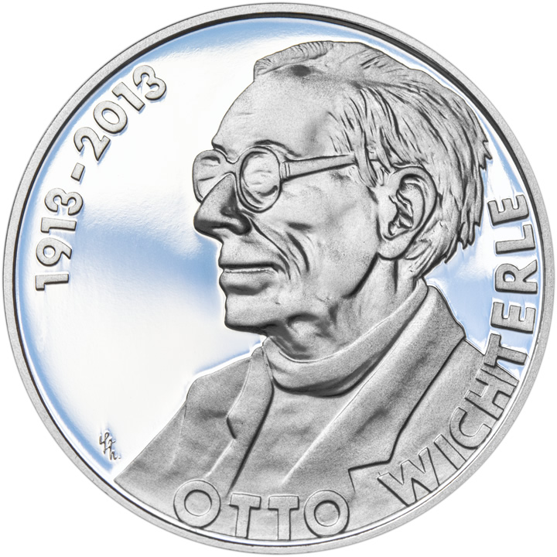
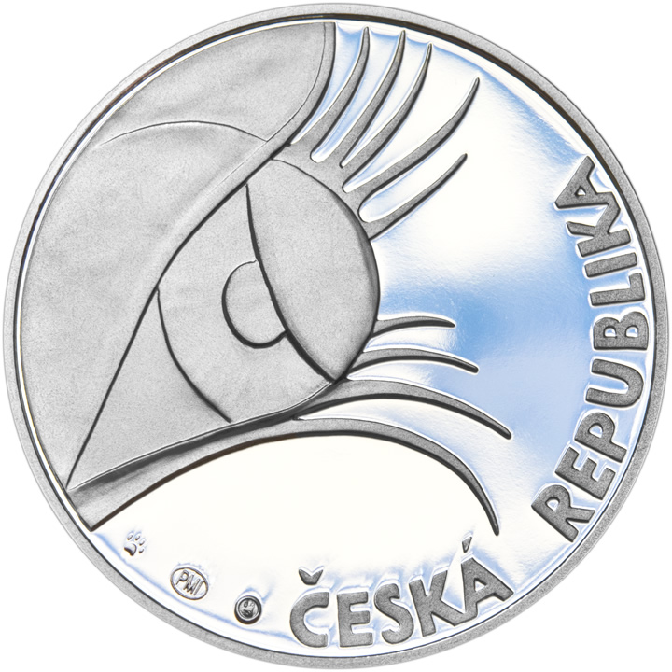
OTTO WICHTERLE 1913-1998ERLE
2013 Czech Republic 200 korun silver coin proposal 1
By Lenka Nebeska Heavenly

Slide 37
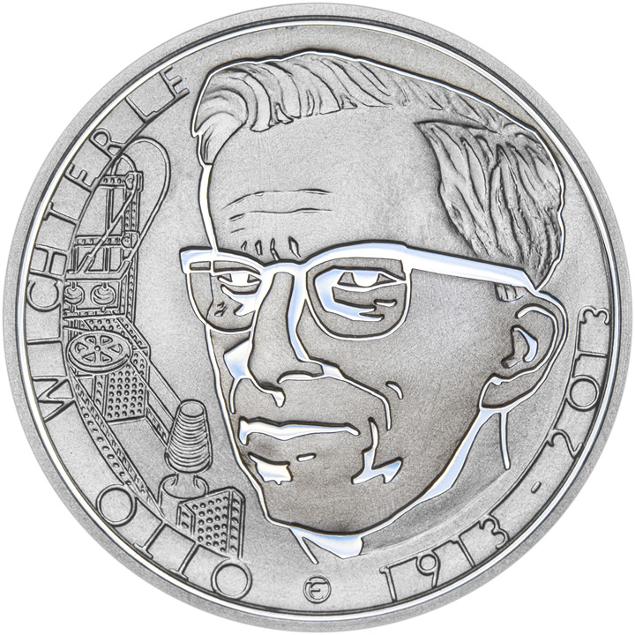
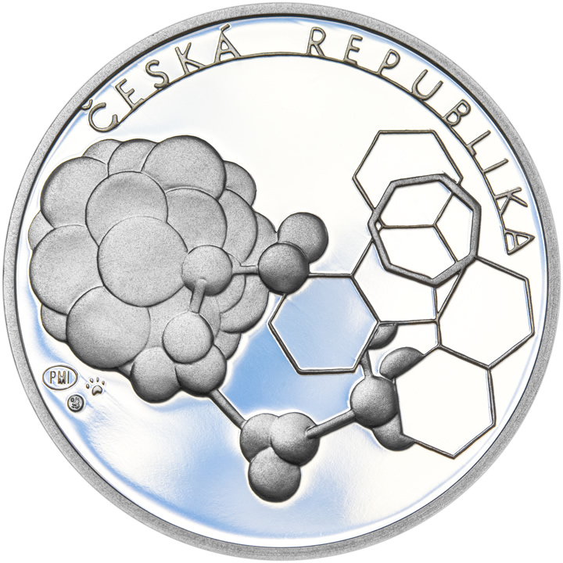
OTTO WICHTERLE 1913-1998ERLE
2013 Czech Republic 200 korun silver coin proposal 2
By Tereza Eisnerova

Slide 38
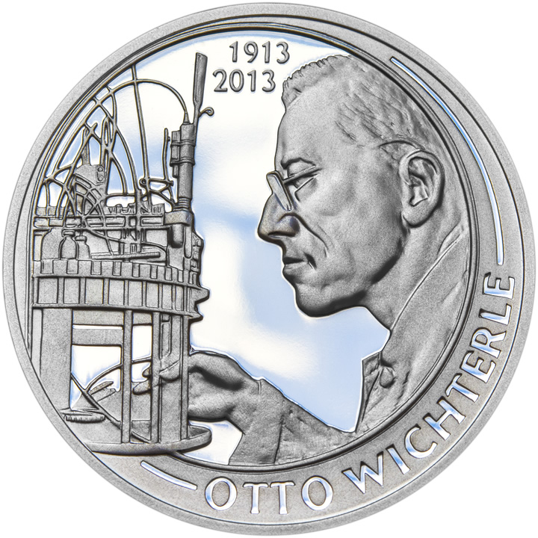
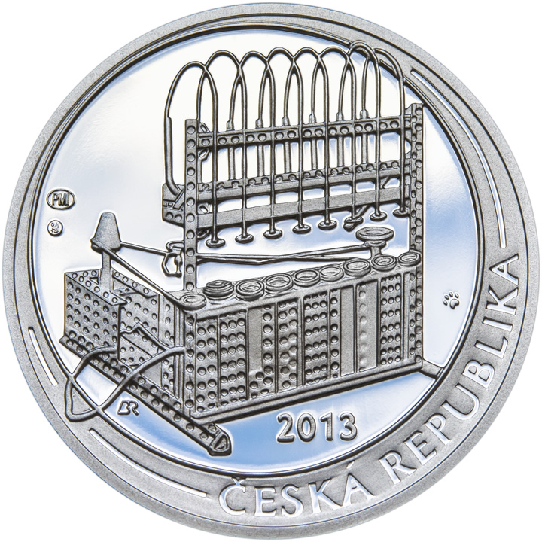
OTTO WICHTERLE 1913-1998ERLE
2013 Czech Republic 200 korun silver coin proposal 3
By Branislav Ronai

Slide 39
OTTO WICHTERLE 1913-1998RLE
2013 Czech Republic 200 korun silver coin proposal 3

Slide 40
OTTO WICHTERLE 1913-1998
SUMMARY

Slide 41
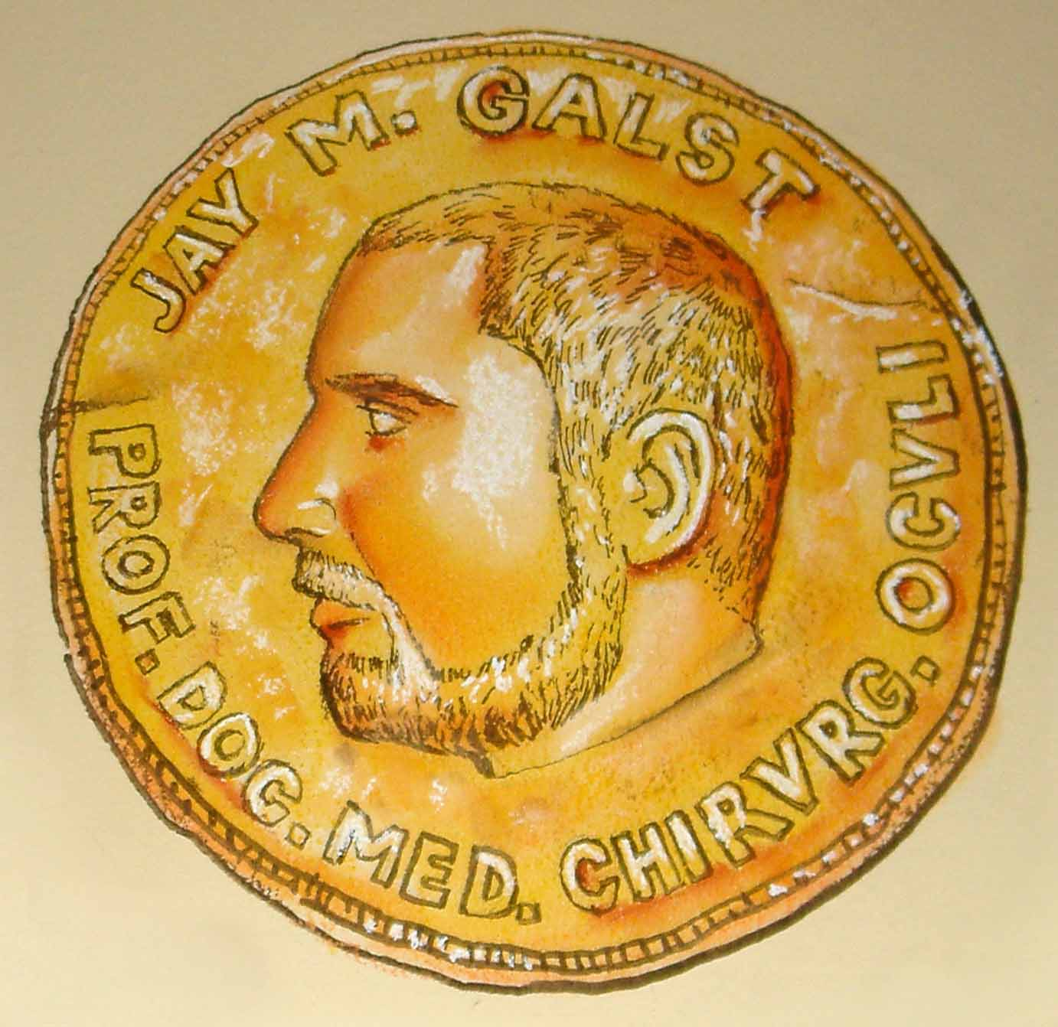
OTTO WICHTERLE 1913-1998
Thank You For Your Attention

Slide 42
OTTO WICHTERLE 1913-1998
Thank You For Your Attention

