Slide 1
The John McAllister Dynasty - A Myriad of Images
David A. Fleishman, MD
Ocular Heritage Society
Philadelphia, PA
April 29, 2017

Slide 2
Chuck’s Wonderful Presentation -
The Major Points and Conclusions
Over the course of five generations, John McAllister and his descendants were eyeglass manufacturers (beginning around 1815), also businessmen and collectors.
There were more than ten McAllister family business names beginning about 1783 (and the shops moved around a bit).
John Sr. and John Jr. worked with some very famous people.
John McAllister Sr was a pioneer of the optical business in the US and he is considered the Father of Opticianry.
Besides being the birthplace of the nation, Philadelphia became the birthplace of optics and optometry in the USA.

Slide 3
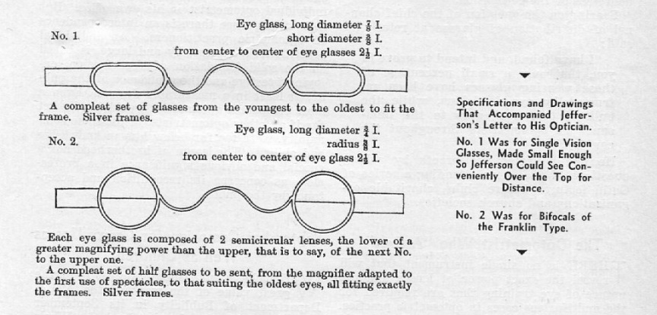
McAllister Sr and Thomas Jefferson
Nov 1806 -1809 correspondence – McAllister had made glasses for President Jefferson for reading (to look over the top) only 7/8 inch wide and 3/8 inch high – 2 ½ inch center to center. Very “convenient” but convergence not taken into account by Jefferson.
Jefferson also wanted bifocals (per Ben Franklin) of ¾ inch diameter – as a series of lenses. But those ½ lenses moved because of the circular frames (glue had to be supplied). Therefore small oval frames were made instead.
Sketches with specifications
indicated exactly the kind of
glasses Jefferson wanted
There were even letters into 1814
(housed at the Library of Congress)

Slide 4
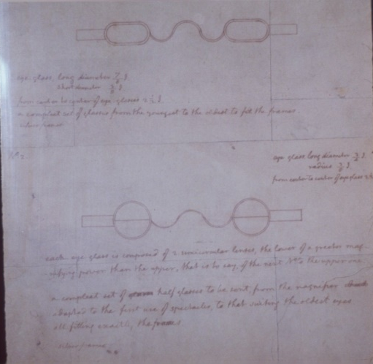
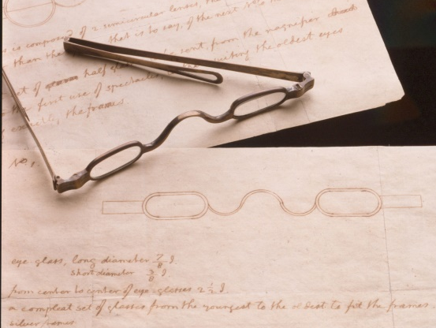
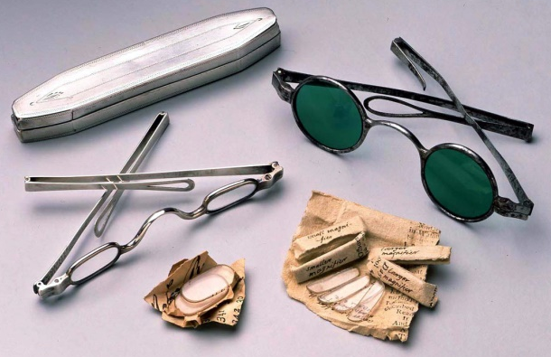
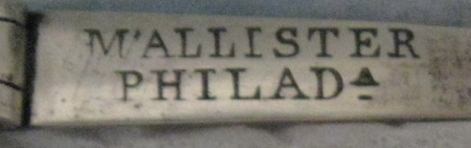
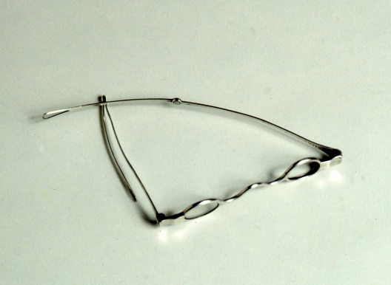
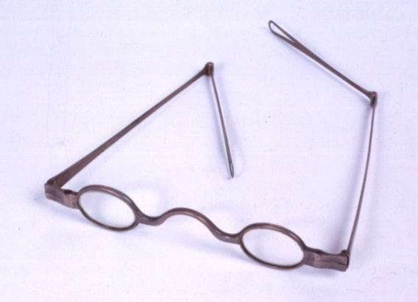
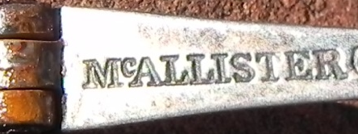
McAllister and Jefferson’s Monticello
earlier version +
bifocal lenses
“believed to have been used”
100% proof does not exist
1806 sketches
mark on earlier version
Philad
6 pedal flower
mid-1820s, at Monticello
but no mark
mark seen on > ½ dozen
known later specimens

Slide 5
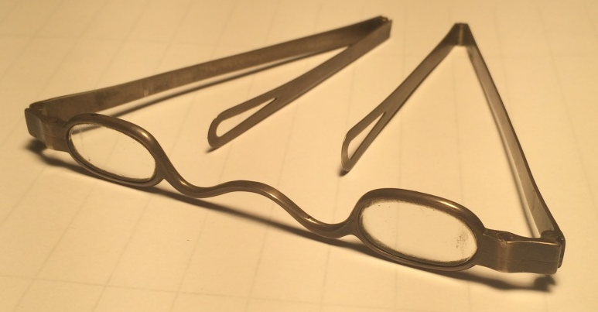
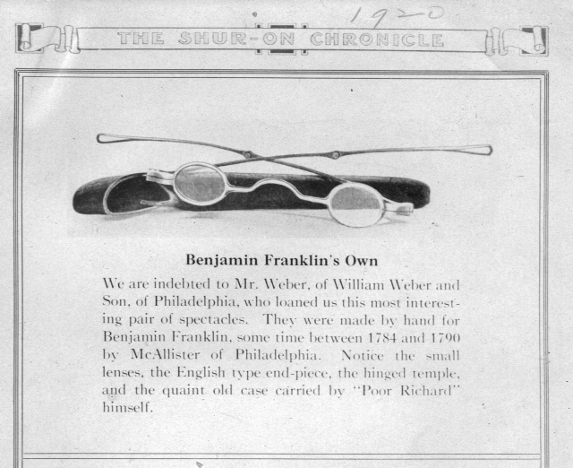
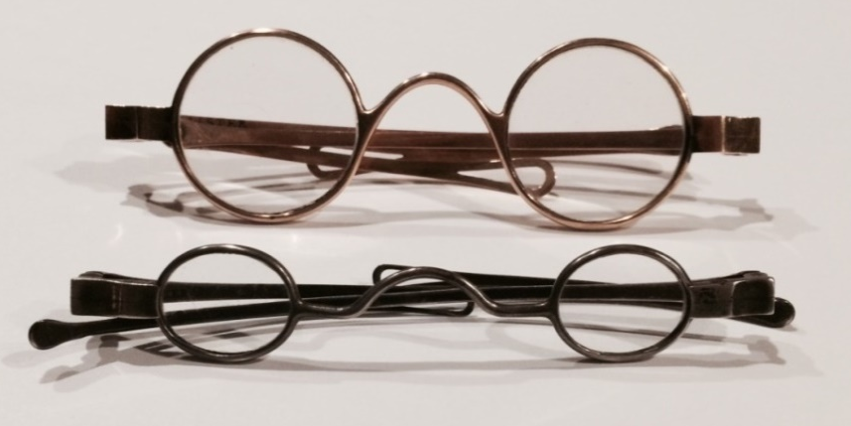
More on Jefferson/McAllister
original, myopia correction, no maker’s mark
ride high on the nose….for distance
well-made EARLY circa pre-1815
Do you believe everything you read?
Note size comparison
Both have McAllister marks
upper - circa 1815
lower - circa 1825

Slide 6
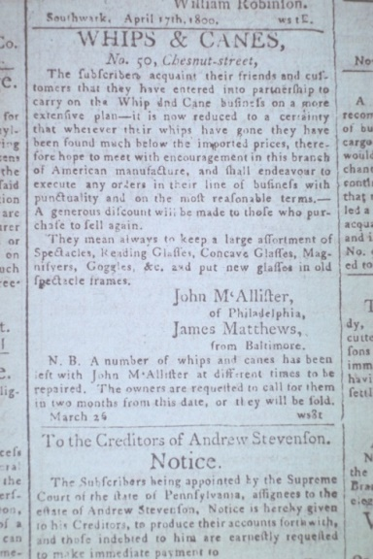
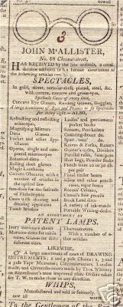
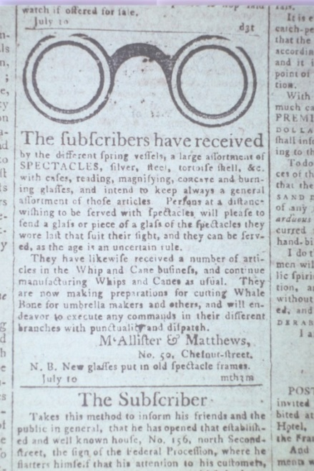
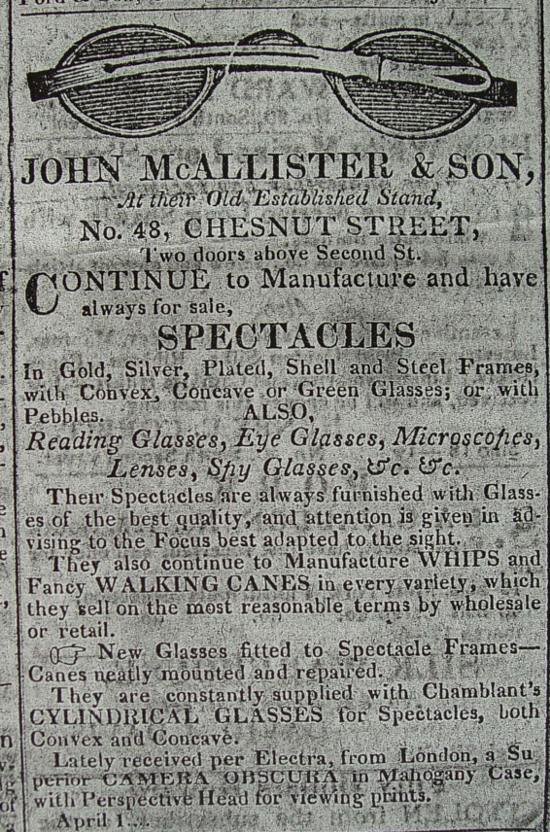
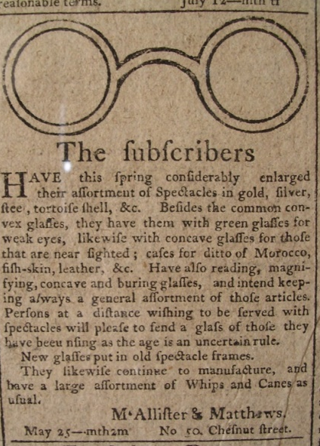
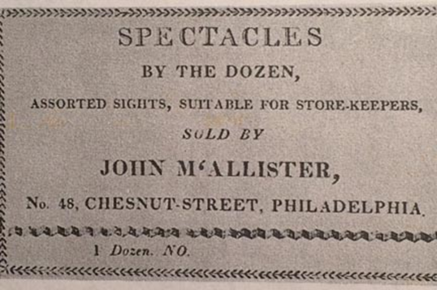
Advertisements
1800, McAllister
and Matthews
M + M
1804
1825
1802, M + M

Slide 7
Marks on Spectacles
“McAllister marks reveal an evolution. These marks were not just a simple label on a product. These were placed on the sidearms of hand-made spectacles created by members of a devoted family over three generations who served their communities in optical-related activities for a total of five generations (173 years in all).”
“I can't prove it, but I doubt that any of the McAllisters personally made frames - silver soldering with an alcohol lamp and blow-pipe is NOT easy, and takes lots of practice. A seven-year apprenticeship was expected for silver and gold work.” (done by employees and subcontractors). McBrayer.

Slide 8

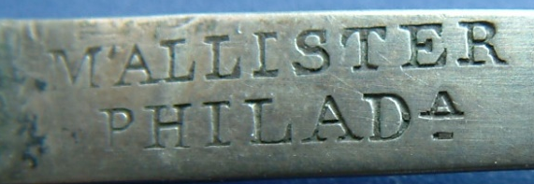
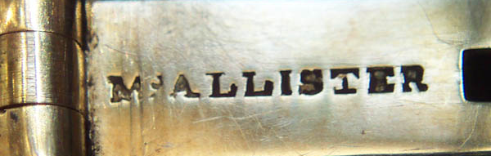
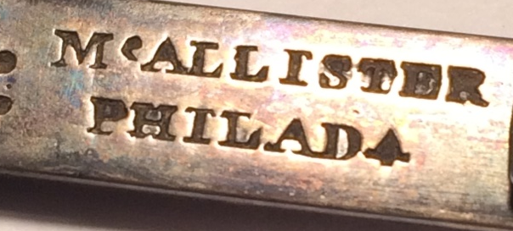
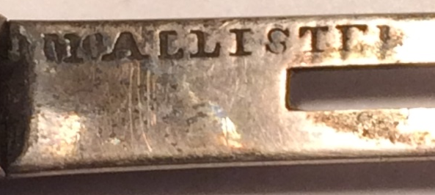
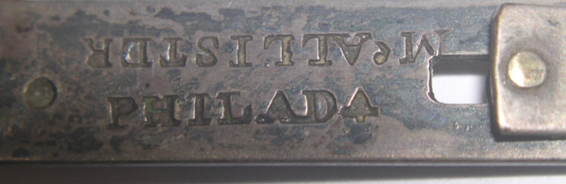
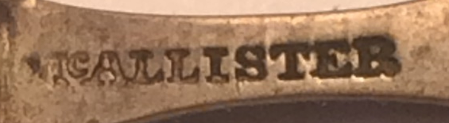
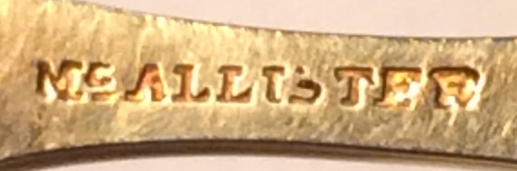
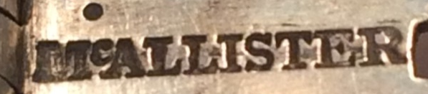
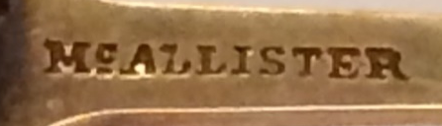
McAllister Marks, 1815 >>1860s
M’ALLISTER 16 mm
earliest PHILAD
Occasionally close
Occasionally far
11 mm
Could this actually be first?
Upside down
Harvard Historical Society
McAllister 14 – 16 mm
Philad 11 – 13 mm
Missing Philad
Tiny bar
under
the C
9 - 11 mm
8 mm
6 mm
Conclusion: definitely more than one stamp for any given designation/period

Slide 9
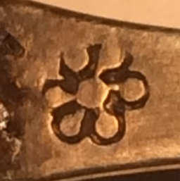
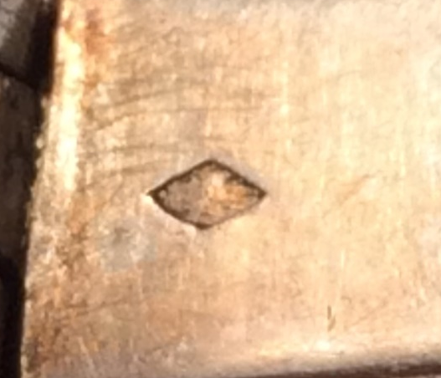
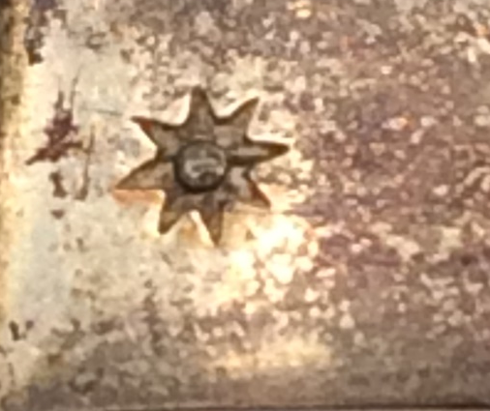
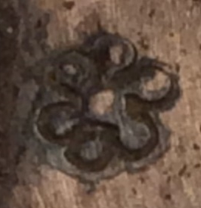
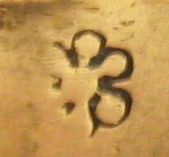
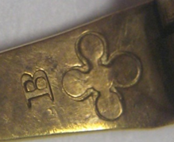
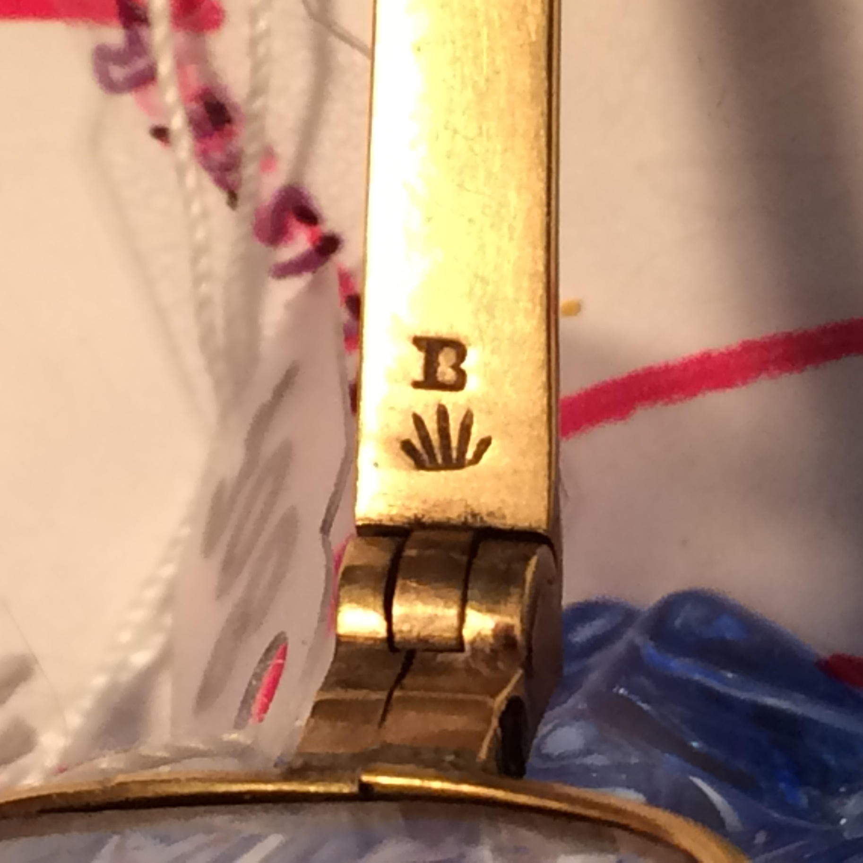
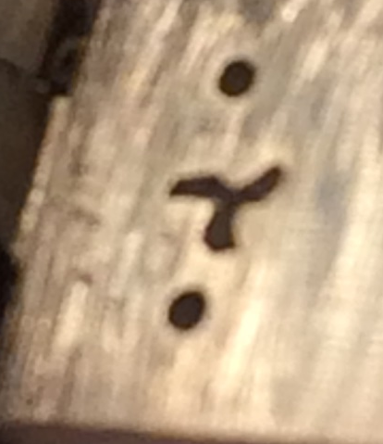
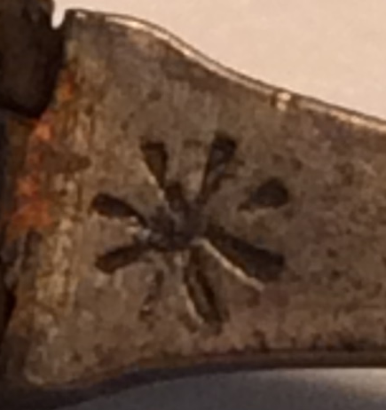
Symbols on Frames
6 Pedal
FLOWER
Likely the mark of a journeyman,
someone working for a “Master”
per Library Co of Phila

Slide 10
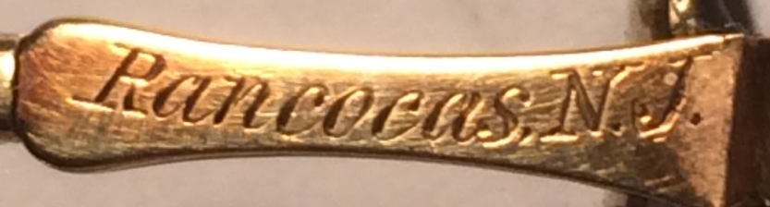
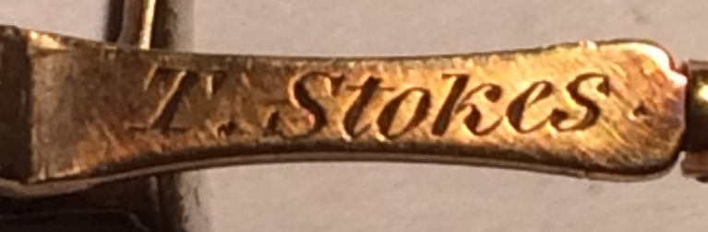
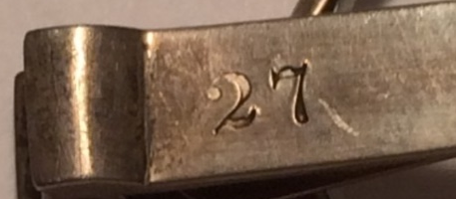
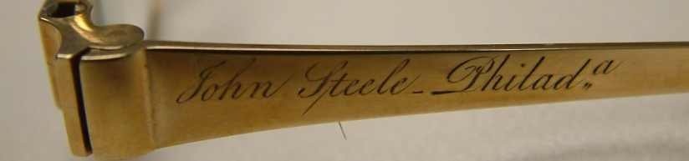
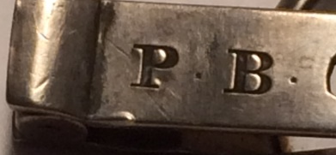
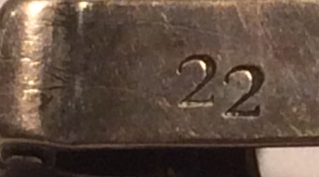
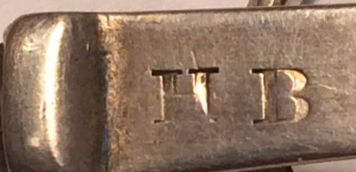
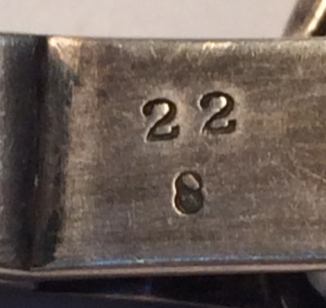
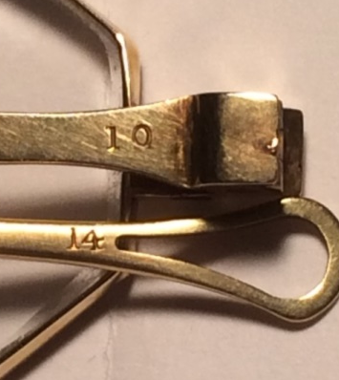
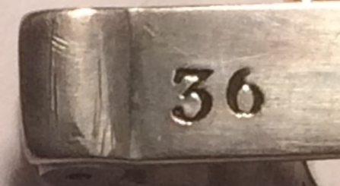
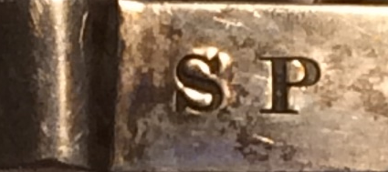
Names and Numbers
John Steele
Revolutionary War General
Focal length
Gold content
circa 1830
bifocals
Lens strength
initials

Slide 11
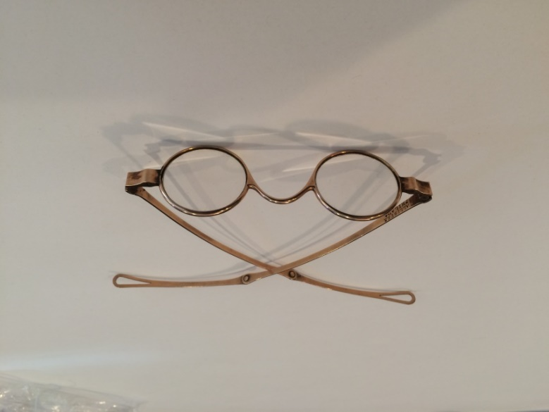
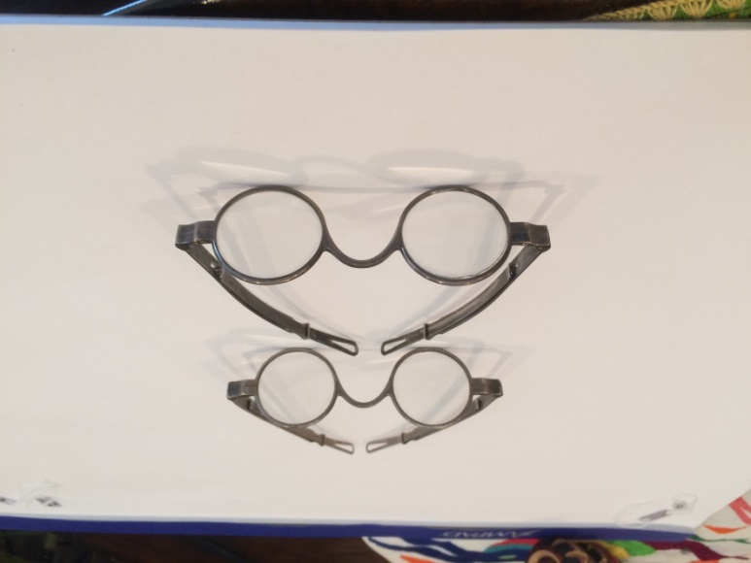
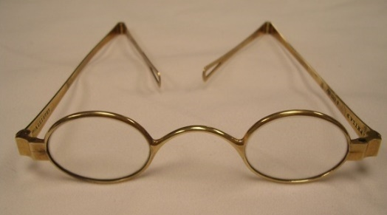
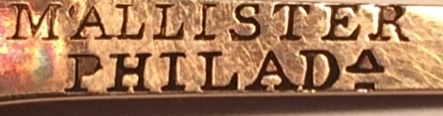








Uncommon McAllister spectacles from my experience
General John Steele
notice the marks
round
round
I doubt this is plated
earliest mark

Slide 12





Early labels and advertising quite rare in my experience
Notice the apostrophe
Engraved paper, c. 1800
John Sr’s 2nd business card
Date?

Slide 13










Cases “rarer than the glasses in DAF’s experience”
“from over a hundred year period”

Slide 14






Personal items of John Sr.
Wax seal stamp
Grandfather clock
Mitchell & Sons, Glasgow, Scotland
Courtesy of Dr. William T. McAllister
Philadelphia Museum of Art,
NOT original to the painting

Slide 15



Business Receipts
1830
1836
1853

Slide 16





John, Jr at the counter
John, Jr to the far right, note the 728 in the front window
McAllister and Brothers
1855
Magic lantern glass slide
shipping box

Slide 17





Notice line under the little “c”

Slide 18


Earliest Shop Image
“J. McAllister & Son”
But the business name changed
When John Sr died in 1830
notice too the gilded Franklin bust
1843, John McAllister, Jr. posing outside
family business at 48 Chestnut Street.
(Library Co of Philadelphia)
DETAIL

Slide 19


1843 – no people
Franklin iconic bust is missing
2. Daguerreotype by William G. Mason,
June 17, 1843. (The Library of Congress)

Slide 20





Later images
4. McAllister & Co
3. 1853 daguerreotype
#48 – McAllister & Co
(Nelson Atkins Museum of Art)

Slide 21








Catalogues
1867
DETAILED.
It is amazing
how much
they knew
back then
Franklin’s
gilded bust
McAllister and Brothers
1856
1882

Slide 22


Trial lens set from 1888 catalogue
Business listing, 1882

Slide 23
Other items
Camera lenses, hygrometers, prisms, magic lanterns and slides, air pumps, spyglasses, thermometers, tape measures, mirrors, camera lucidas, microscopes, laude Lorraine mirrors, rain gauges, stereoscopes, globes. stereo cards, galvanic batteries, field glasses, surveyor’s compasses, etc.

Slide 24





More instruments
opera glasses
telescope
mathematical instruments
microscope

Slide 25




Other images
stereo view ink stamp
1867
stereo view stamp
George Washington
cdv, reverse
stereo view label

Slide 26




Trade cards

Slide 27
Family Members as Collectors
A memorial published at John McAllister Jr.’s death described his “collection of ancient pamphlets, newspapers, maps, and manuscripts being large and well-arranged”
The John A. McAllister Collection held by the Library Company of Phila has thousands of items encompassing some of the same classifications as his father’s collection, but few with a provenance to connect them to John McAllister Jr. and his famous antiquarian library described in Watson’s Annals (1905 edition) as “rich in works of all kinds.”
The Library Company holds a HUGE extensive McAllister family collection of materials (over 50,000 Civil War era manuscripts, graphics and ephemera). Plus the handwritten family history.
ILAMO has the personal papers of John McAllister, Jr. dating from 1822.
Winterthur has lots of paper material.
Chester Country Historical Society holds the largest collection of
McAllister spectacles I have seen – several dozen.

Slide 28
Key Points McAllisters Impact on Opticianry and Optometry
1st generation John McAllister Sr was a pioneer of the optical business and he is considered the Father of Opticianry.
2nd generation John McAllister Jr worked at Wills Eye Hospital as first American hospital optician. He was the first to grind a cylindrical lens to correct astigmatism, 1828.
3rd generation William Young McAllister taught refraction at Wills Eye Hospital
Over the years, many members of the family members became opticians.
4th generation Francis Wardale McAllister became an optician in Baltimore in 1868 and thereafter an optometrist in 1879. He was an early member of Maryland Board of Optometric Examiners and also a founder of the American Optometric Association.
McAllisters taught ophthalmologists how to refract (beginning in the 1870s). That testimony was provided under oath by the grandson during a legal proceeding before the Pennsylvania Court of Common Pleas in 1914.
McAllisters played a role in the early development of optometry and optometry laws.

Slide 29
Should there be a Pennsylvania Historical Marker to Honor the McAllister Name?
“Absolutely Yes”.
The Pennsylvania Historical and Museum Commission administers the program. Nominations must be submitted by December each year. Once approved new markers are dedicated in public events presenting the opportunities for everyone to celebrate our heritage.
A committee has been formed:
Chief Curator, Independence National Historical Park, National Park Service.
Two nationally recognized opticians
One nationally recognized optometrist
Yours truly
The Process has Begun………….

Slide 30
In Conclusion
The John McAllister Dynasty (about 173 years)
Theirs was a gradual change from prolific spectacles maker (optician) into optometrists. A feature article in the Baltimore Sun (newspaper) in 1972 described the five generations of McAllisters as “one of the most distinguished and remarkable families in the American history of optometry.”
Also Think About This
From its birth here in Philadelphia the McAllister’s work has evolved to become a highly respected profession which benefits hundreds of millions yearly all around the world. Individuals young and old have their eyes examined and then get a new pair of glasses.

Slide 31
Special Thanks
Cohen Collection
Letocha Collection
McBrayer Collection
Rosenthal Collection at the Museum of Vision
Tull Collection
Eric Muth’s research notes
Nancy Schiffer’s Eyeglass Retrospective
Heather Edmonds, Librarian, NECO, Boston
Kirsten Hebert, Archivist, AMO, St. Louis
Dr. William T. McAllister, 6th generation down from John Sr.
Library Company of Philadelphia
Monticello/The Thomas Jefferson Foundation
Nelson- Atkins Museum of Art
Philip and Muriel Berman Foundation

